Slide 1
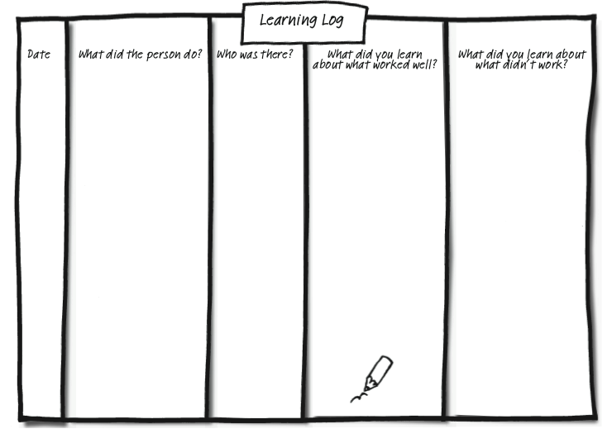
Capturing learning - Learning Log
© TLCPCP 2019 www.tlcpcp.com

Slide 2
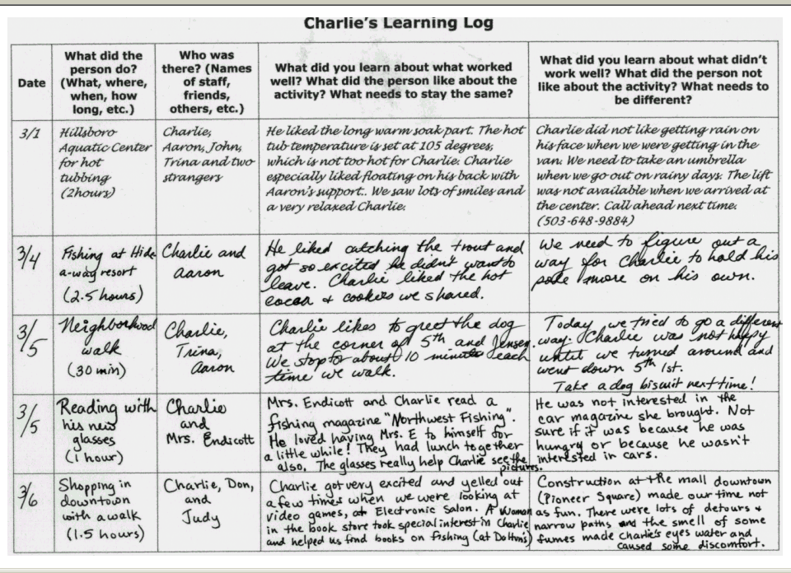
© TLCPCP 2019 www.tlcpcp.com

Slide 3
Charlie’s One-Page Profile for Support Staff
What others like and admire about Charlie
What is Important to Charlie
How Best to Support Charlie

Slide 4
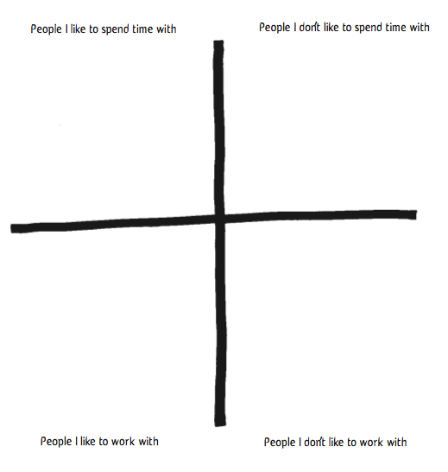
Characteristics of
Characteristics of
Characteristics of
Characteristics of
© TLCPCP 2019 www.tlcpcp.com

Slide 5
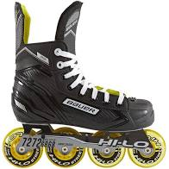
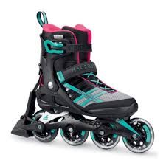

Slide 6
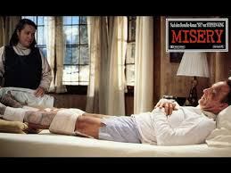
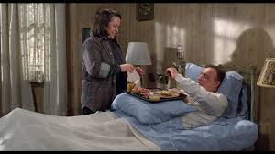
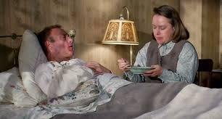
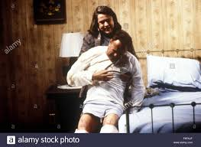

Slide 7
How would you feel?
What would you do?

