Slide 1

Person-Centred Approaches
Session 3

Slide 2
”
Help people get better lives…
…not just better paper
“
© TLCPCP 2019 www.tlcpcp.com

Slide 3
When we listen…
Communication becomes more complex
People become more interested in other ways of communicating
Some people who didn’t use words to communicate start doing so
© TLCPCP 2019 www.tlcpcp.com
Notes:
TLC-PCP www.learningcommunity.us

Slide 4
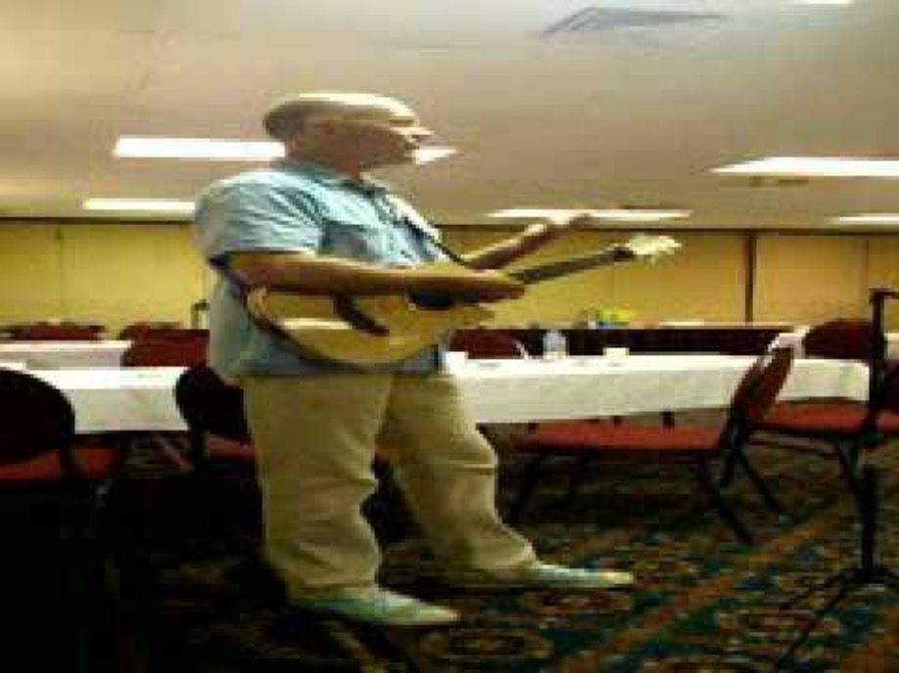

Slide 5
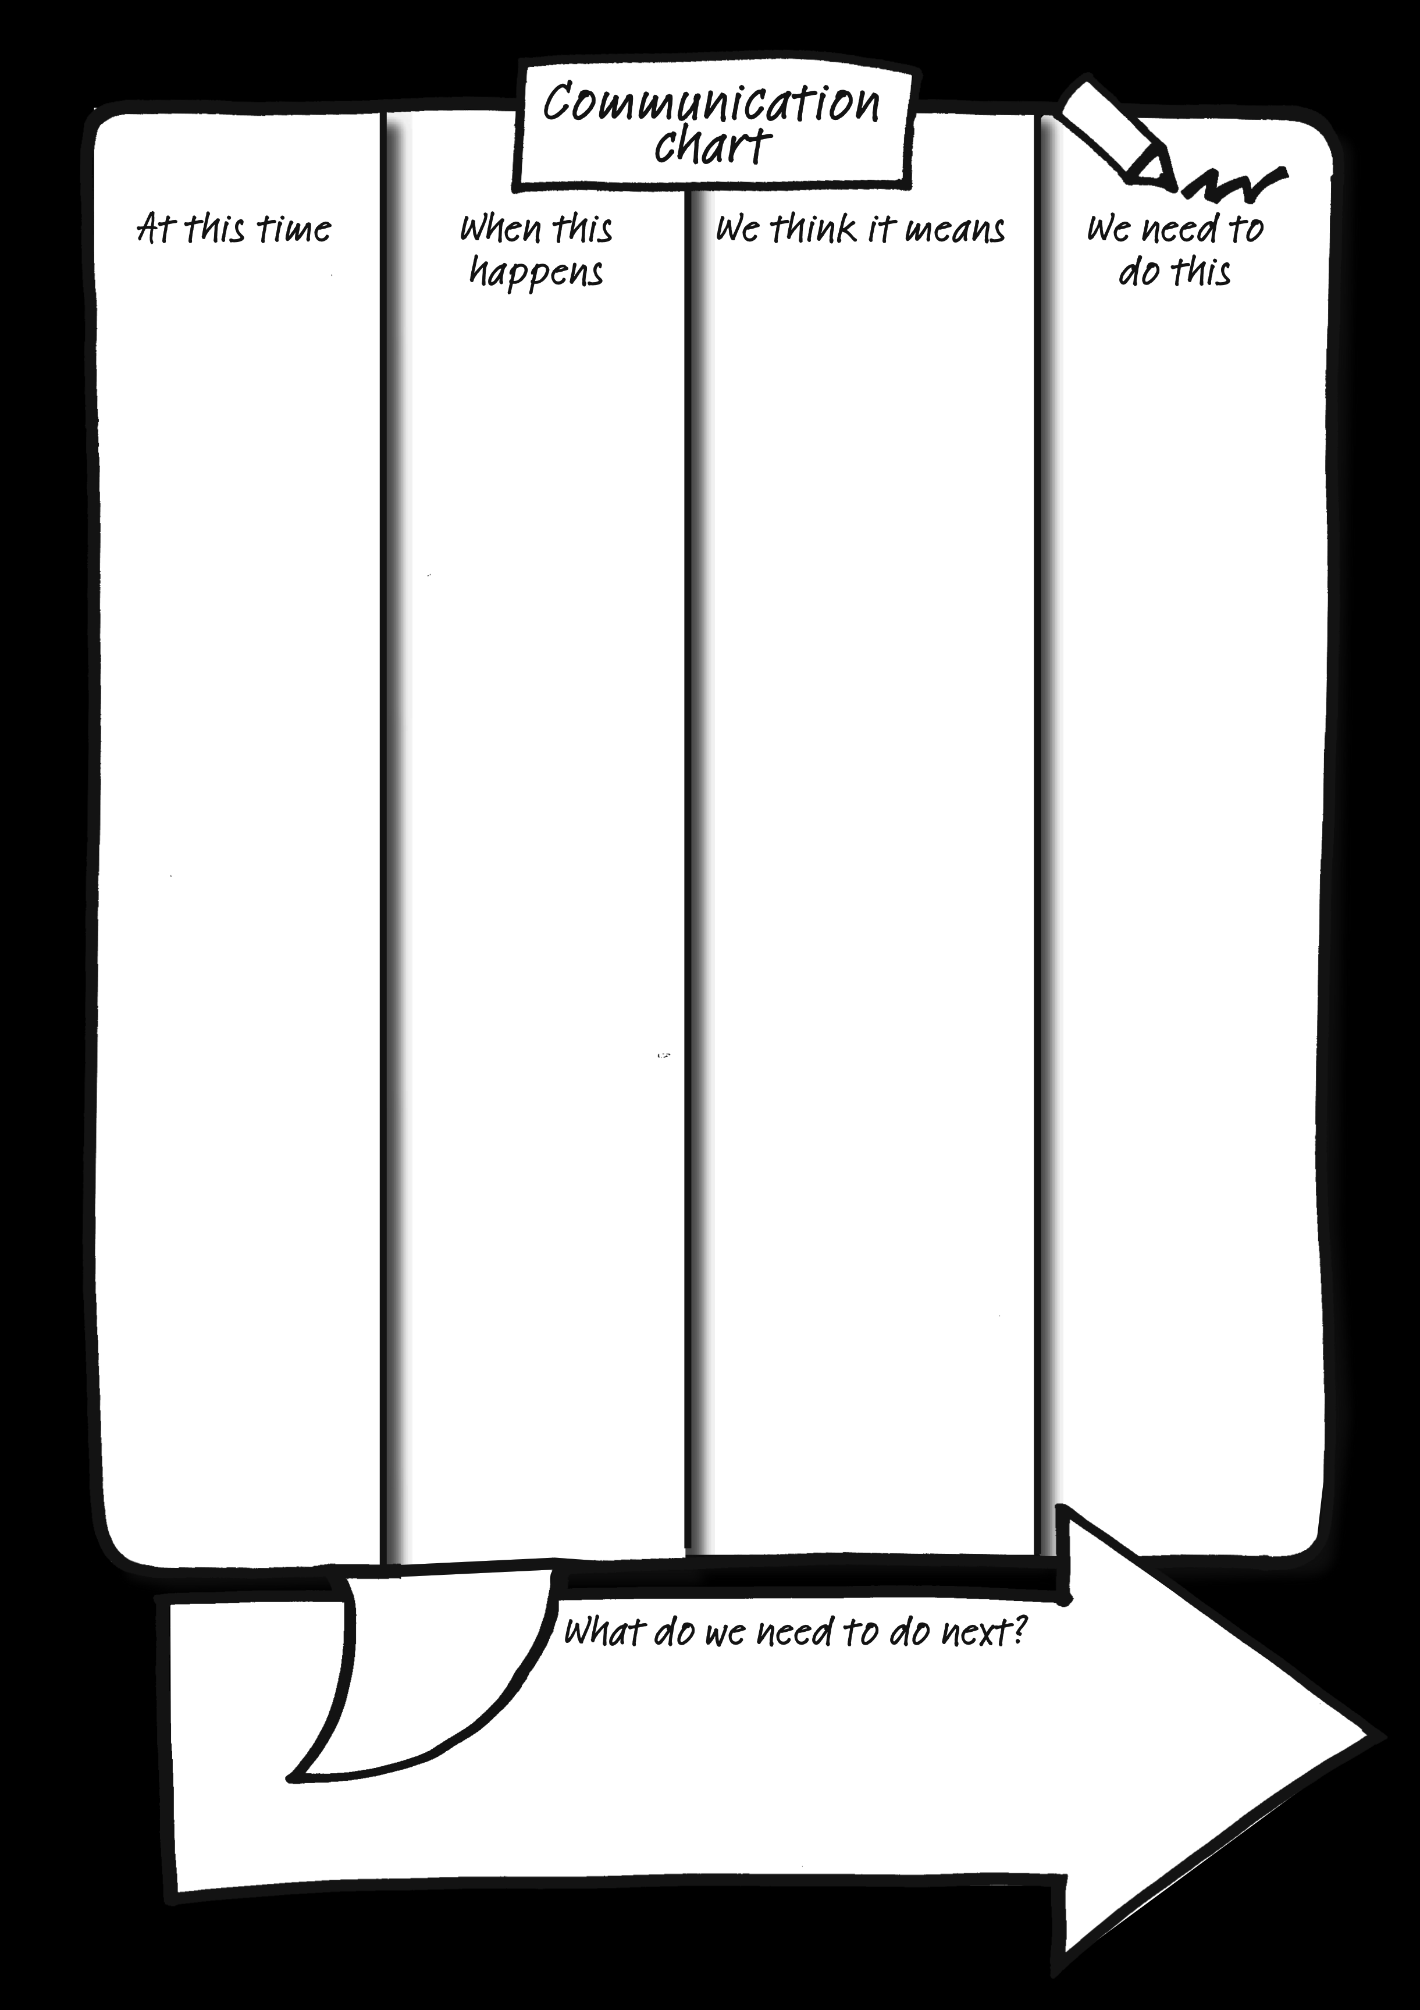
How I communicate
with you

Slide 6
How I communicate with you
Arrives home from college In the environment What’s just gone on The “trigger” | Drops bag to floor, slams door storms upstairs The behavior What others notice Can be seen, heard, and felt by others | She has had a bad day Meaning of the behavior What the emotions and feelings are What’s going on inside | Leave her be she will come and talk when she is ready What other people should do in response Or not do…..
What is happening
Rachel does this
We think it means
And we should
© TLCPCP 2019 www.tlcpcp.com

Slide 7
Breakout rooms
Facilitator
Keep things moving
Remind of 1 person at a time
Encourage everyone to participate
Timekeeper
Keep eye on the clock and give people reminders of how much time is left.
When using timed rounds, let people know when their time is about to end
Recorder/Reporter
Keep notes for the group – point form is fine
Report back to larger group – either verbally or in Chat based on request

Slide 8
Steven’s Communication Chart
What is happening… This is going on… | Steven does this… I do this…. | We think it means… It means.. | And we should… I want you to….
Anytime | Approaches you & scratches his chin | He wants to go to the toilet | Support him to the bathroom
Anytime | Sits rubbing his knees | He is bored | Support him to get set up doing his painting or playing cards with Joe is a favourite – check if Joe wants a game.
Anytime | Approaches you & touches your shoes | He wants to go for a walk outdoors | Go for a walk with Steven – He loves all weathers & isn’t put off by rain – walking over Pendle Hill is favourite, but if time is an issue Steven enjoys a walk around the flower beds in the garden
Sitting in the lounge | Steven bangs his cup on the table | He wants company | Sit with Steven, and chat with him. – the soaps are a favorite conversation topic – any of them. Stephen loves every soap on TV!.

Slide 9
Communication Chart For Chuck
What Is Happening | What The Person Does | What It May Mean | What We Should Do
It is Sunday | Calls afterhours and leaves you a voice mail that includes scripture or singing of a gospel song | Chuck had a great day at church! | Do nothing.
Anytime other than Sunday. | Calls and leaves you a lengthy voice mail that sounds like a sermon. | Chuck might be having some mental health issues. He may have forgotten to take a dose of medication. | Call Chuck and ask if he remembered to take his medication, he will likely check and then tell you yes, he forgot. For the next few days, call Chuck in the morning and offer supportive reminders to take his meds.
Anytime | Makes any mention of “Ruby Red Lights”, even just a passing reference. | Chuck is experiencing auditory hallucinations. (Ruby is deceased and by history is one of the “voices” Chuck hears when he is hallucinating) | Drop by and see Chuck. Check his med box. Stick around and chat for awhile (be on the look-out for any signs that he may be experiencing hallucinations or delusions. Contact his Psychiatrist and take recommended next steps. (Schedule an appointment, increase visits to daily, etc.)
Anytime | Stops eating and tells you that his food has been poisoned or that there is blood in his food. | Chuck is experiencing delusions and auditory hallucinations. | This is an EMERGENCY! Call the Mobile Crisis Unit and support Chuck in being assessed for possible admission. Stay with Chuck until they arrive. Offer reassurances that you are there to help keep him safe. Do NOT try and convince him that his food is not poisoned.
Notes:
TLC-PCP www.learningcommunity.us

Slide 10
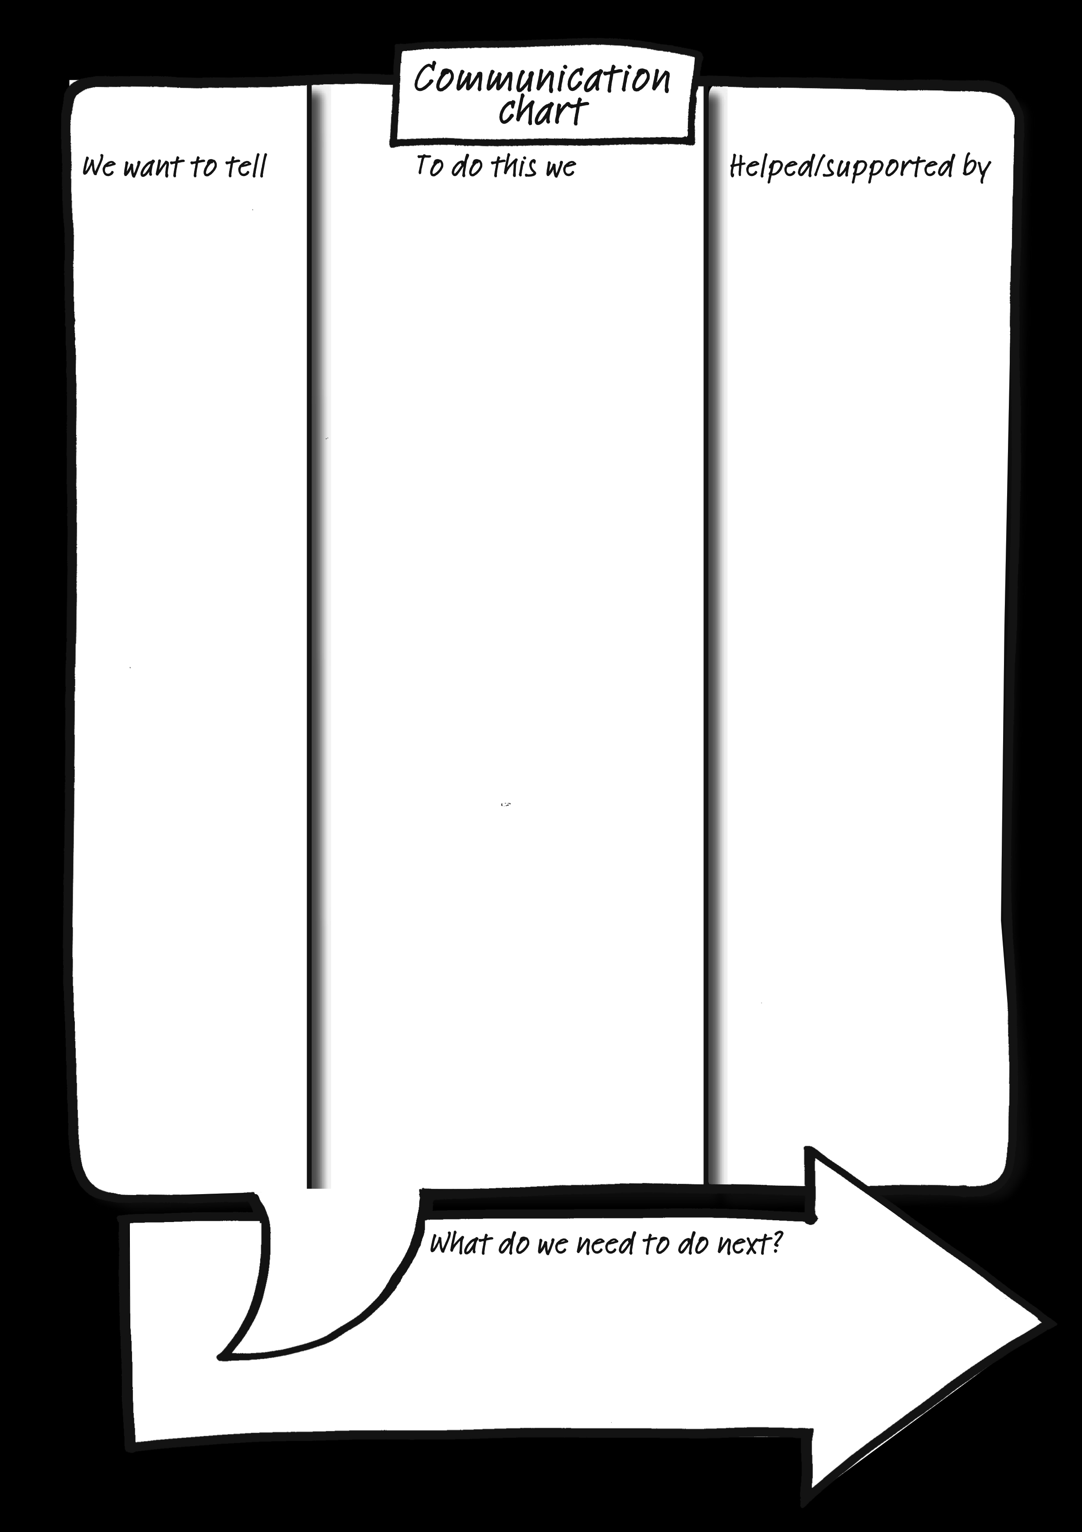
How you
communicate with me

Slide 11
THINGS WE NEED TO COMMUNICATE WITH KYLE
We want to let Kyle know | To do this we | Then support/encourage Kyle to
It’s time to get up (if Kyle is not already awake). | Knock on Kyle’s bedroom door and then open it. | Continue Kyle’s morning routine. See “to be successful”.
It’s time to have a bath. | Run bath while Kyle is in his bedroom and when bath is run open his door. | Kyle will get into the bath unsupported.
It’s time to have a shave. | Show Kyle his razor and shaving cream. | Apply shaving cream and have a shave.
It’s time to have hair washed. | Show Kyle shampoo. | Apply shampoo and have his hair washed.
It’s time to get dressed. | Show Kyle his clothes. | To dressed by letting him know what he needs to do. For example, pointing and tapping his leg to lift, etc.
Breakfast/lunch/dinner is ready. | Show Kyle his meal. Encourage Kyle to go into dining room. | Sit at the table and eat his meal.
It’s time to take medication. | Show Kyle the syringe. | Sip his medication.
It’s time to have teeth cleaned. | Show Kyle his toothbrush. | Come and sit in the kitchen and have his teeth cleaned.
It’s time to go to the toilet. | Show Kyle incontinence pad/leg bags/enema. | Walk to the bathroom by pointing and guiding him by his elbow.
It’s time to go out. | Show Kyle his boots. | Put his boots on and walk to the door.
It’s time to go for a walk. | Guide Kyle past the car to the gate. | Walk at his own pace.
It’s time to go out in the car. | Show Kyle the car keys or rattle the car keys. | Walk to the car.
It’s time to go to the pub. | Show Kyle his pint pot glass. | Support Kyle to go to the pub.
It’s time to buy chocolates. | Show Kyle a chocolate wrapper. | Support Kyle to shop and buy chocolate.

Slide 12
Decision-Making
Types and Processes
Informed decision-making
Supported decision-making
Substitute decision-making
© TLCPCP 2019 www.tlcpcp.com
Notes:
TLC-PCP www.learningcommunity.us

Slide 13
Decision-Making
Spend 10 minutes in your learning groups sharing a significant decision in your life during the last couple of years:
What was the decision to be made?
How did you consider your options?
How were you involved & did anyone help
you with the decision?
Who made the final decision?

Slide 14
Breakout rooms
Facilitator
Keep things moving
Remind of 1 person at a time
Encourage everyone to participate
Timekeeper
Keep eye on the clock and give people reminders of how much time is left.
When using timed rounds, let people know when their time is about to end
Recorder/Reporter
Keep notes for the group – point form is fine
Report back to larger group – either verbally or in Chat based on request

Slide 15
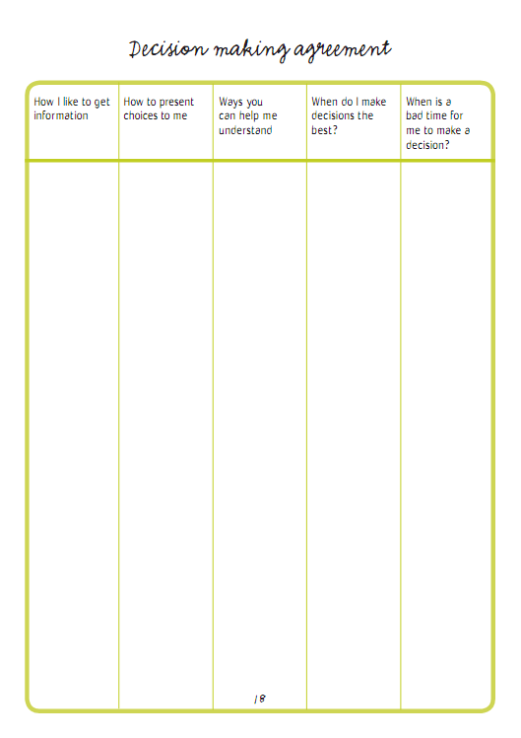
profile

Slide 17
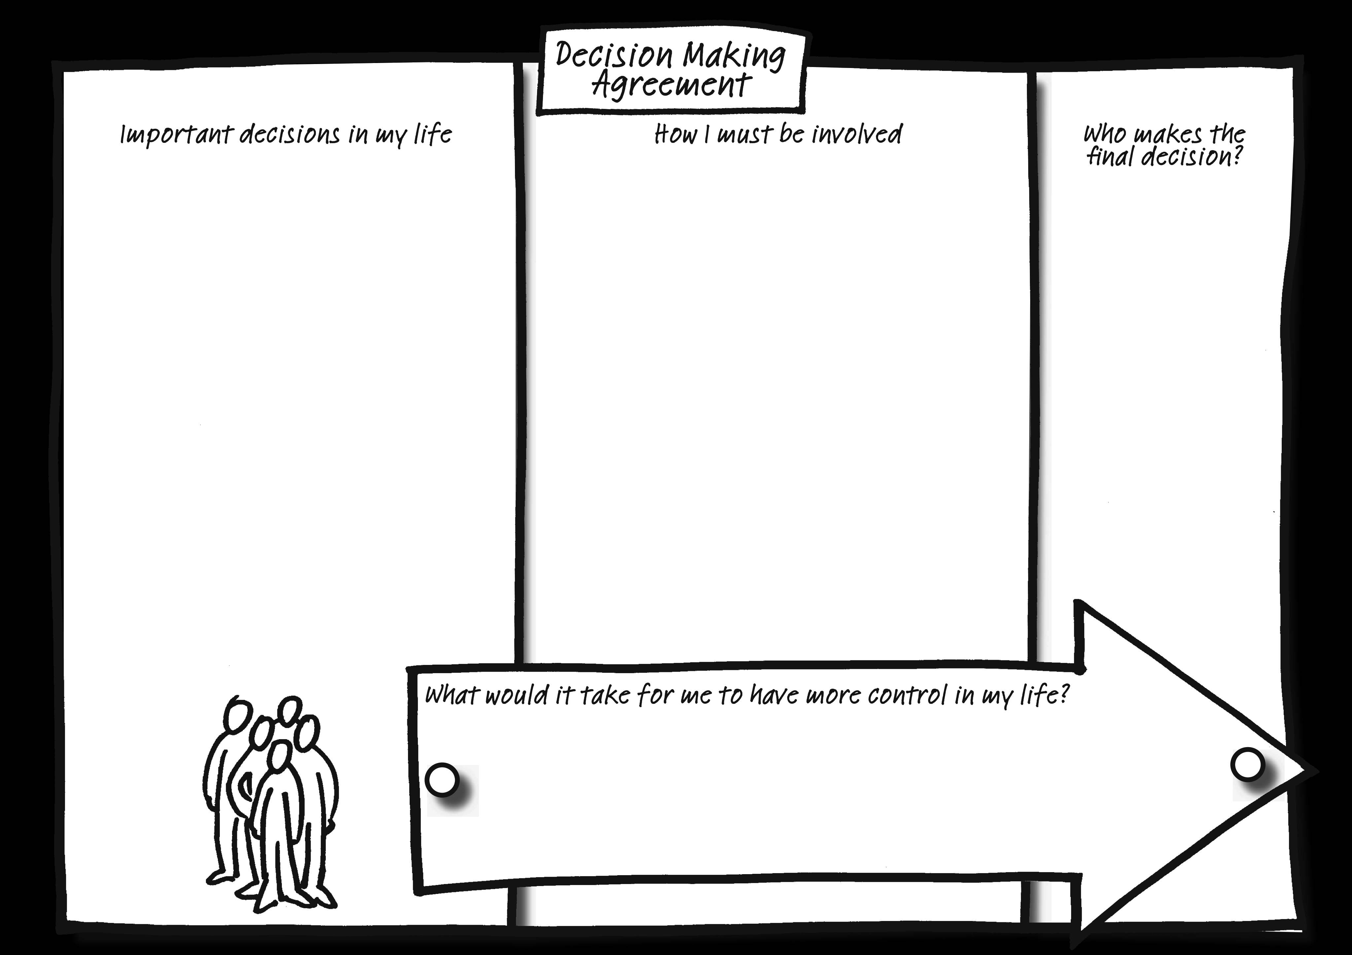

Slide 18
Decision Making Agreement

Slide 19
Decision Making Agreement
Decision to be made | How Gerry must be included | Who makes the final decision
How he spends his money What he eats Where he goes and when How he manages his sleep | Gerry should be consulted and involved in his monthly expenditures and budgeting if he chooses and can decide how to spend his daily money Gerry must participate in his grocery shopping and choose the foods that he wants to buy, his supports are with him and can encourage him to buy a balanced diet Gerry has the freedom to travel the city alone, when there are concerns for his safety supports, mom will discuss and educate and ensure a crisis plan is in place Involve him in all medical appointments and decisions about potential strategies to address insomnia | Mom manages the finances and makes the final decision about how money is managed and how much Gerry gets daily Gerry decides what he will eat Gerry decides where he will go and when Mom and Gerry will decide together which strategies to try

Slide 20
When I have company coming over
  I am not comfortable unless my home is perfectly clean
I am ok with my home whatever the state
What is one other cultural thing you do to prepare your home for company?

Slide 21
When I have guests
I always offer them food and/or drink
I do not offer them food and/or drink
If your guests are there for a meal, do you serve alcohol with the meal?

Slide 22
When guests dine with me in my home
  I expect them to stay for a while after the meal
I expect them to leave as soon as the meal is eaten
What do you do if your guests offer or even insist on helping with dishes and clean-up?

Slide 23

Keep Culture in Mind
Culture is:
  About why you think things are right and wrong, good or bad, how things are supposed to be.
  Is learned and shared knowledge that specific groups use to generate their behavior and interpret their experience of the world. It includes, but is not limited to communication, rituals, and roles.
Culture can be revealed in comments like:
That is not how we do things in our family
That is not right
Nice people don’t do that
Women/men don’t do that
You will embarrass the family
That is against my (our) religion
People with disabilities shouldn’t (cannot) do that
That is not something we talk about
Those providing support should:
Be aware of their own cultural assumptions
Be prepared to express their own point of view in a transparent way when necessary
May need to:
Think about what the other person’s cultural values might be and check with them
Plan how to explain cultural issues--be understood and respected yet flexible
Be prepared to have more than one conversation
Slide Source: © 2014 - Georgetown University Center for Child and Human Development and © 2016 Georgetown University National Center for Cultural Competence

Slide 24
Histories
A conscious effort to find out and record a person’s stories can tell us so much, about them as a person, about what’s important to/for them, and who is in their life (or used to be)
Visual methods of capturing and sharing histories really helps – a powerful photo or graphic speaks a thousand words

Slide 25
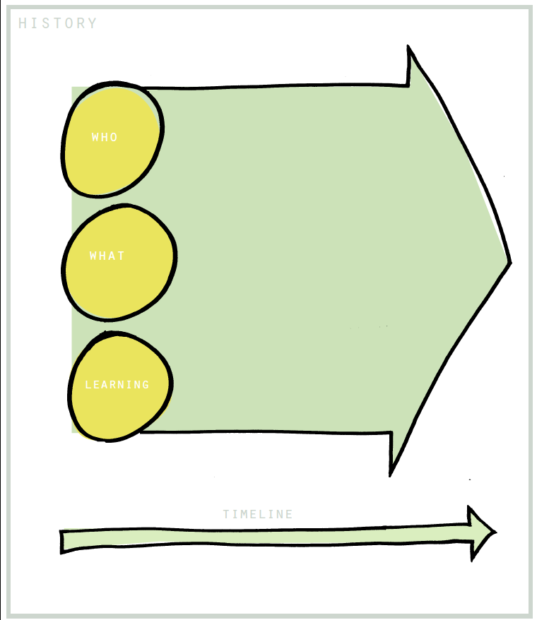

Slide 26
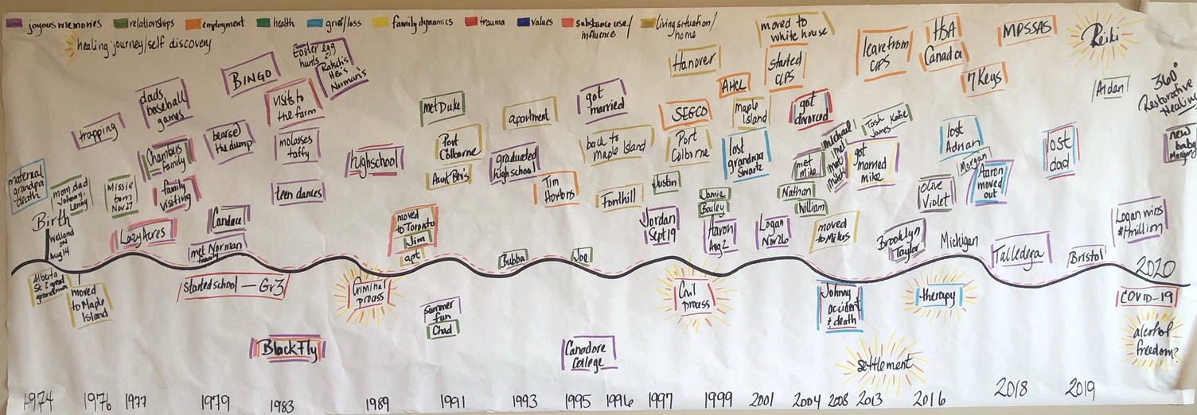
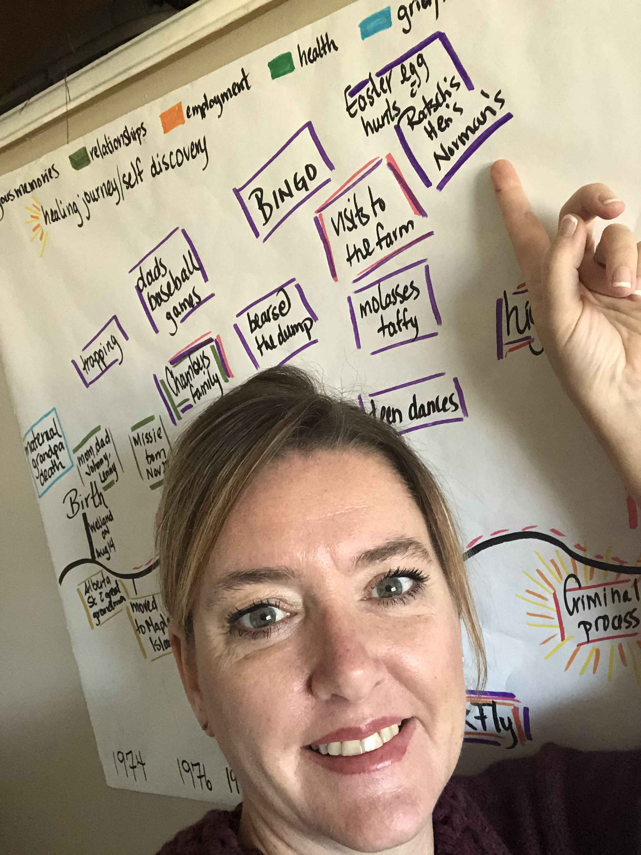
Barb’s history
key learning experiences
celebrations

Slide 27
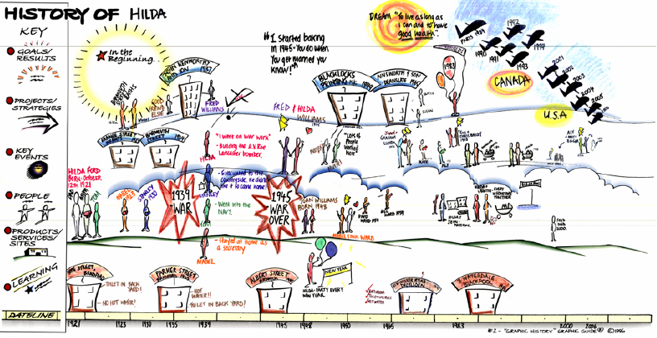
‘Some day, I may not remember what a
great life I have lived so far.’

Slide 28
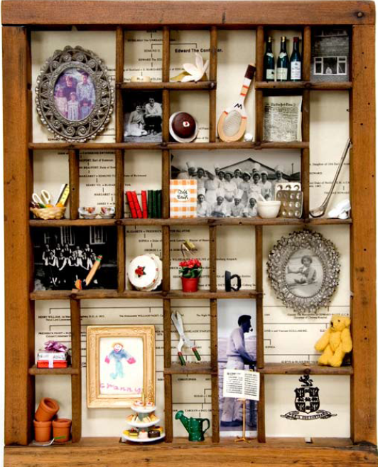
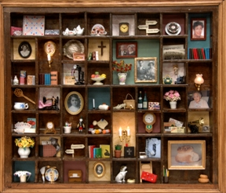

Slide 30
Organizing Discovery Information
Three ways to organize discovery information
Person centred description
Person centred / directed plan
One-page profile
© TLCPCP 2019 www.tlcpcp.com
Notes:
TLC-PCP www.learningcommunity.us

Slide 31
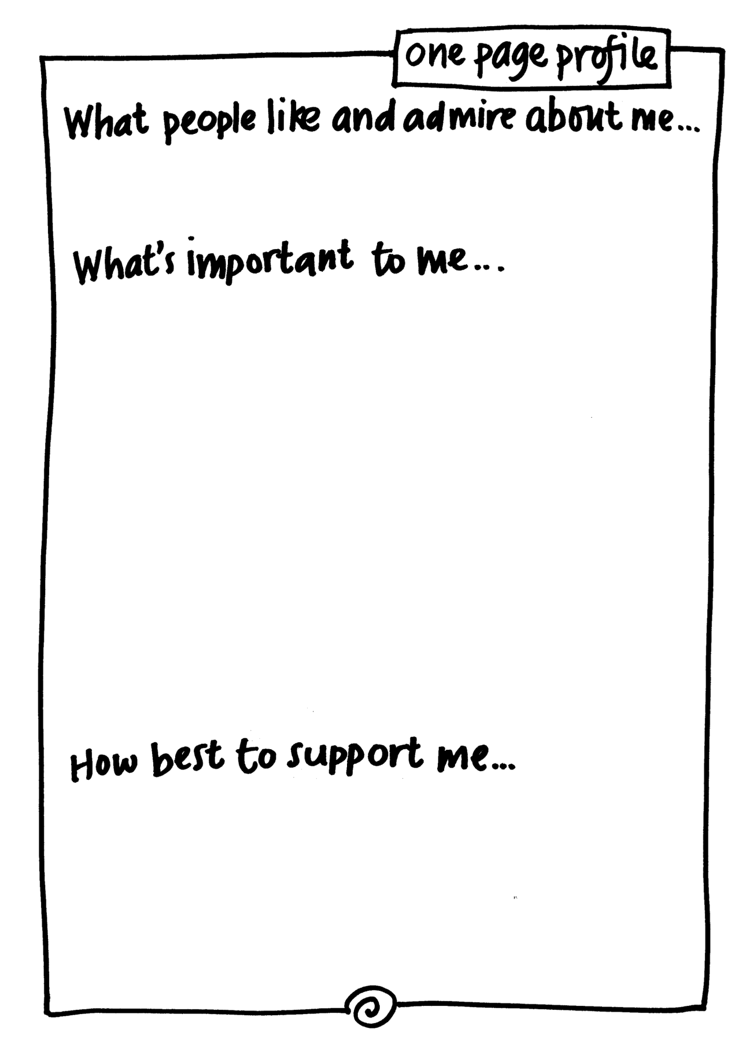

Slide 32
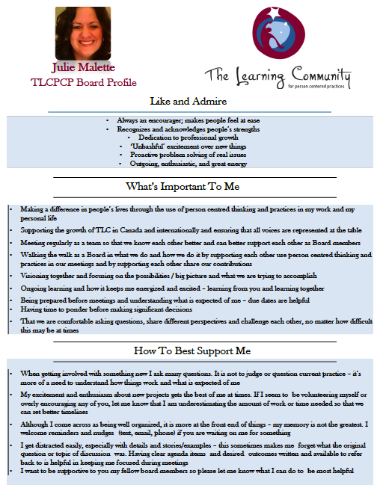

Slide 34
Relationship Circle
Circle of exchange
Circle of participation
Circle of friendship
Circle of
intimacy

Slide 35
Relationship Map
family
work
school
daytime
home and other paid support
Friends and other non-paid supports
Notes:
PURPOSE:
Relationship map
To teach people a good way of finding out who is important to the person.
To identify who to talk to and involve in person-centred planning and supporting the person
To emphasize how different the relationships are in their lives when compared to many people who use services.
TALKING POINTS:
Review your own relationship map with the group (on flip chart)
Let people know that they will only have a five minutes to fill this out, so they may not have time to be thorough or thoughtful. Tell them “this is training and we want you to know how the various pieces work but you will not have time to finish everything.”
Then –
Ask people to start with their partner’s name in the center (unless you do it individually) and only share what you are comfortable sharing.
Let people know that it is emotional distance that determines where names go, not how close the “blood” relationship is. Note that if you changed how you feel about someone their name could move closer to the center or further away. Also note that this is more about emotional connectedness and strength of feelings toward a person vs. how much time they spend with them
When people start to struggle with the quadrants for people who are paid – ask them where they would put their doctor, the person who cuts/does their hair. Other people that they see regularly and pay
When they are done (or out of time) note that this –
Gives us a picture of who is in someone’s life and who they care about
Gives us ideas about who we should talk in order to develop a good picture of what is important to the person
Ask how their “map” would compare with that of the people who use our services
TOOLS:
Flip chart paper with your own relationship map drawn on it.
FACILITATION TIPS:
Start by using your own example on flipchart, use a few personal examples to explain and emphasize the key messages. Know ahead of time which examples you will use.
Keep in mind that this is one of the areas where you could spend 5 minutes or 25 minutes. Some people will not have time to complete it. Part of what you want people to see is how their “maps” are rich in friends and have few people who are paid, whereas the “maps” of people who use services are often the reverse.
Wrap-up the exercise by asking participants for their thoughts on how this tool might be helpful in their lives/work.
TIME: 10 minutes

Slide 37
Relationship Circle and Map
Who in the person’s circle can help connect them to other people in their circle or to new people?
Does the information gathered help identify relationships that could be developed and strengthened?
Is there a good balance of family, friends, and paid workers in the person’s life?
How should we gather the information so it is useful to the person? Some people prefer to use photos to develop their relationship circle.
Are all the people important to the person mentioned in their ISP/Person-Centred Plan? Have we learned anything new we need to add?
Are there any actions we can set based on what we have learned?
© TLCPCP 2019 www.tlcpcp.com

Slide 38
Practical application
Communication charts
Create a communication chart with someone you support – choose the most appropriate chart for the situation
Decision Making tools
Use the decision-making profile or agreement with someone you support – what did you learn?
Relationship Circles and Maps
Use the relationship circle or map with someone you support – what did you learn?

Slide 39
www.hsacanada.ca
www.tlcpcp.com
Barb Swartz-Biscaro
barbs@hsacanada.ca

