Slide 1
Person-Centred Approaches
Session 1

Slide 2
Breakout rooms
Facilitator
Keep things moving
Remind of 1 person at a time
Encourage everyone to participate
Timekeeper
Keep eye on the clock and give people reminders of how much time is left.
When using timed rounds, let people know when their time is about to end
Recorder/Reporter
Keep notes for the group – point form is fine
Report back to larger group – either verbally or in Chat based on request

Slide 3
Each of us want lives where we are
supported by & contribute to our communities
Have our
own dreams and our own journeys
Have opportunities to meet
New people; try new things; change
jobs; change who we live with & where we live
Have what/who is important to us in everyday life; people to be with; things to do, places to be
Stay healthy & safe (on our own terms)
© TLCPCP 2019 www.tlcpcp.com

Slide 4
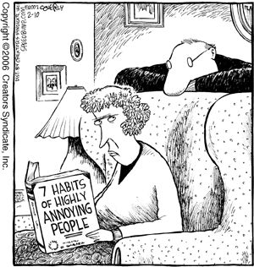
What grates on your last nerves?
© TLCPCP 2019 www.tlcpcp.com

Slide 5
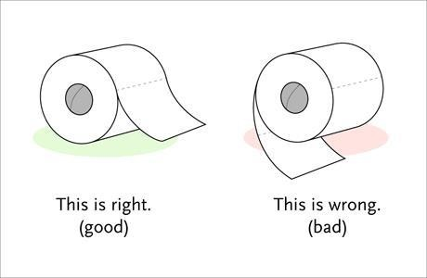

Slide 6
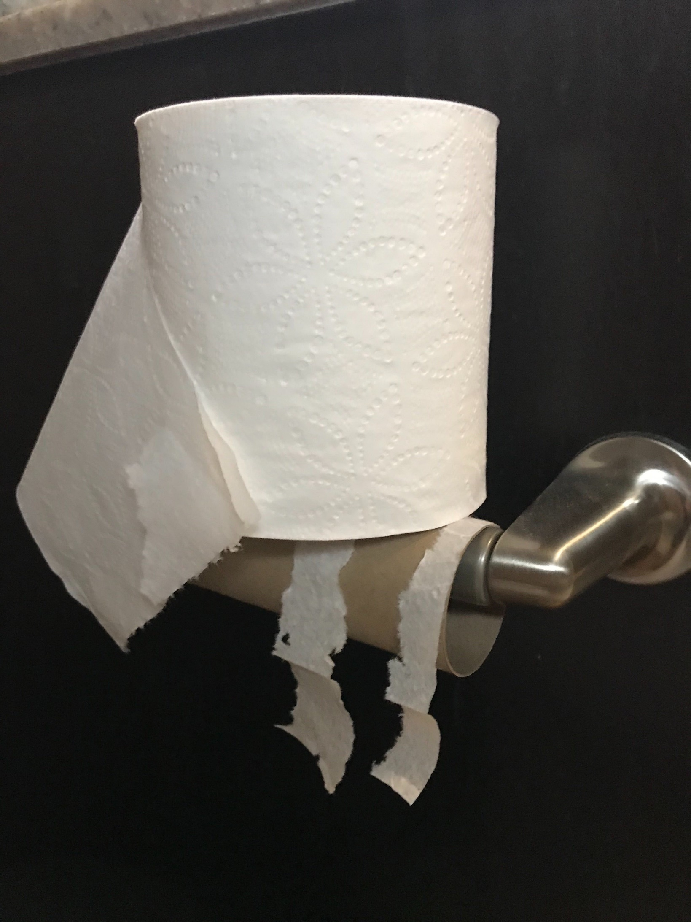

Slide 7
Things that people do at home
that gets on your last nerve

Slide 8
How do you react? What do you do?

Slide 9
1 year later
same situation plus a system response
How do you feel now and what do you do?

Slide 10
5 years later
person-centred planning
No change
How do you feel and what do you do?

Slide 11
What would it take to trust?

Slide 12
Person-centred planning or using person-centred thinking tools is a set of promises
To listen
To act on what we hear
To be honest
© TLCPCP 2019 www.tlcpcp.com

Slide 13
”
Help people get better lives…
…not just better paper
“
© TLCPCP 2019 www.tlcpcp.com

Slide 14
Importance Of Environments
Toxic
Tolerated
Healing
Supportive
Causes significant aggression or depression.
What is toxic to one person may not be toxic to someone else
Results in Power Over as we try and control the aggression or withdrawal
People are depressed, have given up.
We see “learned helplessness”
May have been toxic but people feel powerless
There is no (or very little) growth
Power Over
In a supportive setting there is growth.
People have moved from toxic or tolerated “blossom.”
There is Power With
This is the minimum for everyone.
Needed for some people wounded by toxic or tolerated settings
Focus is on restoration and wellness. There is a need to partner with clinical supports
Power With
© TLCPCP 2019 www.tlcpcp.com

Slide 15
“
Person-centred thinking and planning is a process of continual listening and learning, focusing on what is important
to someone now and in the future and acting upon this in alliance with their family and friends.
Michael Smull
”

Slide 16
Introducing the Core Concept:
important to
and
important for
AND
The balance between them
© TLCPCP 2019 www.tlcpcp.com

Slide 17
Important TO
What is important to a person includes those things in life which help us to be satisfied, content, comforted, fulfilled, and happy. It includes:
People to be with /relationships
Status and control
Things to do and places to go
Rituals or routines
Rhythm or pace of life
Things to have
© TLCPCP 2019 www.tlcpcp.com

Slide 19
“Nacho naps in my fanny pack until 12 noon every day”

Slide 20
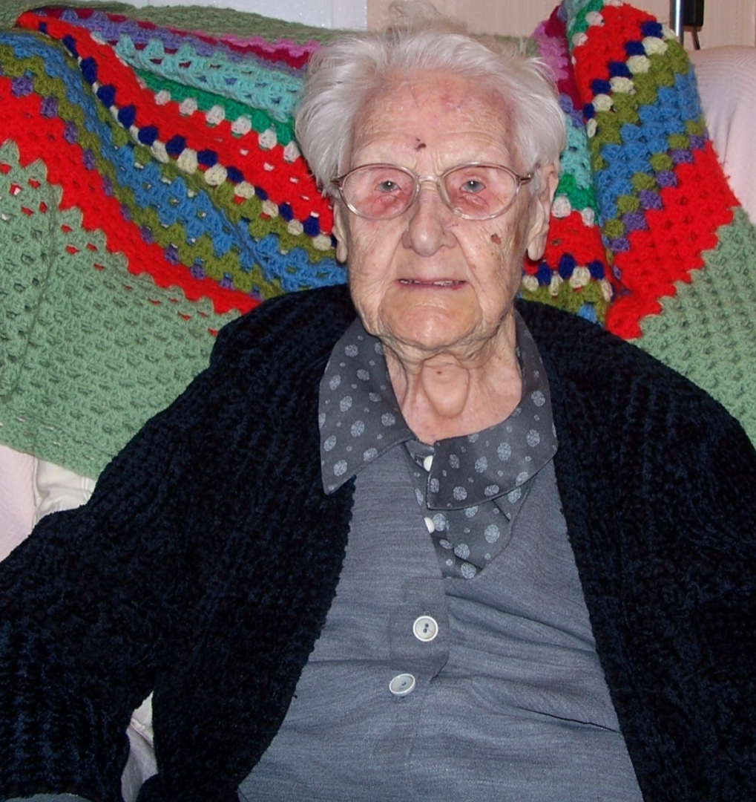
‘ I might be 104 but I enjoy my nip of whisky in my tea and a wagon wheel for supper, it’s gorgeous.’

Slide 21
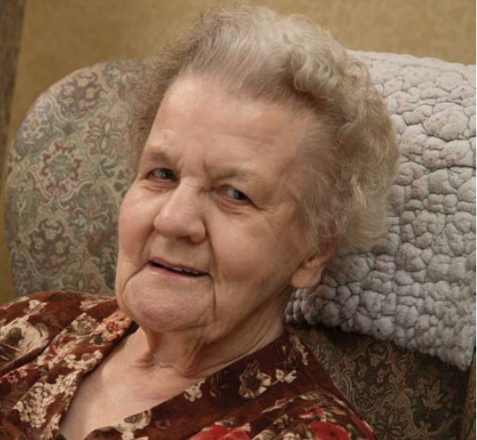
‘It’s awful when you are in bed & you don’t know what time it is. The night seems to go on forever’

Slide 22
Important FOR Part One
Issues of health:
Prevention of illness
Treatment of illness / medical conditions
Promotion of wellness (e.g.: diet, exercise)
Issues of safety:
Environment
Well being ---- physical and emotional
Free from fear
© TLCPCP 2019 www.tlcpcp.com

Slide 23
Important FOR (Part Two
What others see as necessary to help the person:
Be valued
Be a contributing member of their community
© TLCPCP 2019 www.tlcpcp.com

Slide 24
all choice no responsibility
to

Slide 25
All choice: No responsibility

Slide 26
Health and safety can dictate
for

Slide 27
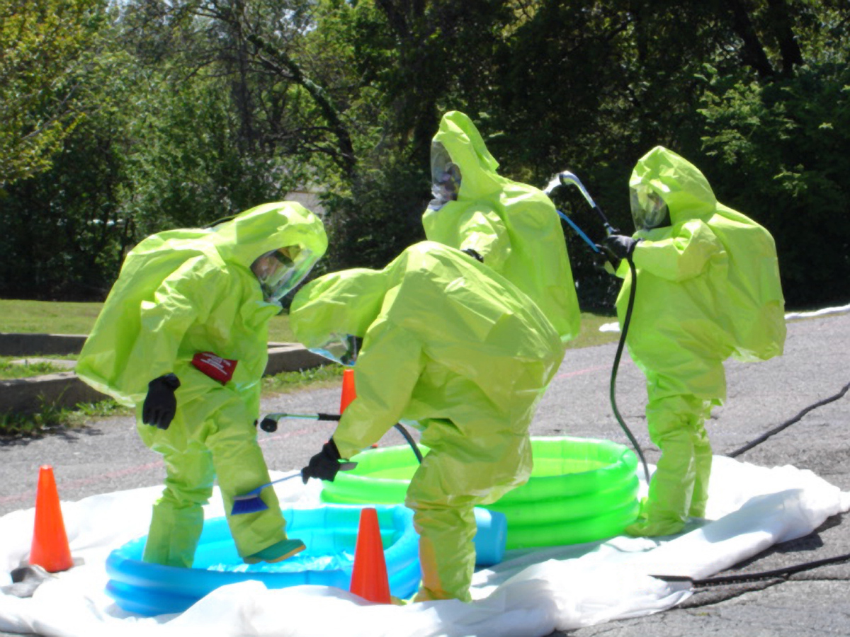
Health and Safety can dictate life

Slide 30
The Mom song
The Mom song video

Slide 31
balance
to
for

Slide 32
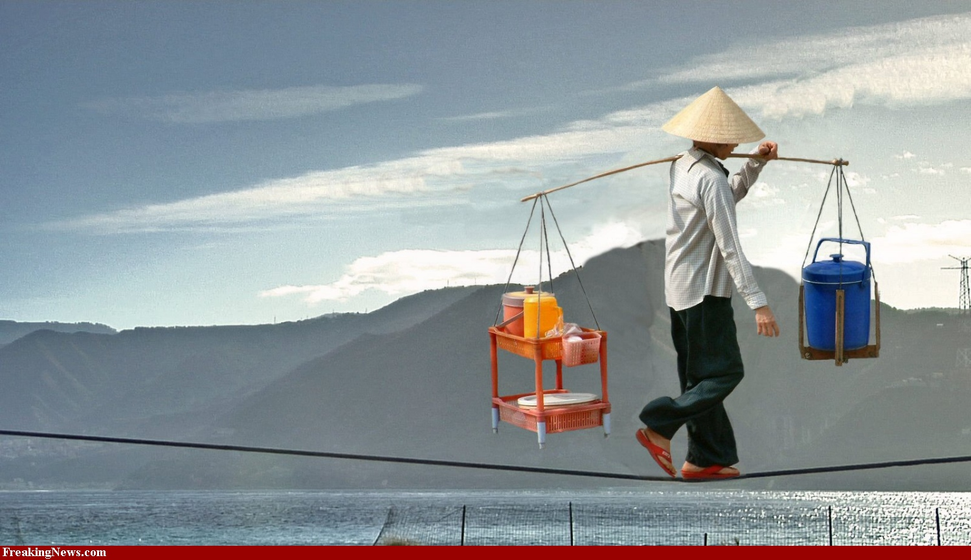
Balance means

Slide 33
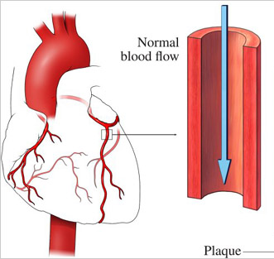
Julie’s balance
balance

Slide 34
Choice and Balance
As we think about choice, we can see
- All choice can be irresponsible (happy and dead)
- And dictating lifestyle is unacceptable (alive and miserable)
Good support means finding the balance
- Finding the balance can create conflict
- We all have a right to make choices, even bad choices
© TLCPCP 2019 www.tlcpcp.com

Slide 35
Breakout rooms
Facilitator
Keep things moving
Remind of 1 person at a time
Encourage everyone to participate
Timekeeper
Keep eye on the clock and give people reminders of how much time is left.
When using timed rounds, let people know when their time is about to end
Recorder/Reporter
Keep notes for the group – point form is fine
Report back to larger group – either verbally or in Chat based on request

Slide 36
What are you struggling to balance?
Notes:
36
Group activity – 8 minutes

Slide 37
Control of the “W’s”
The Person has positive control over the “w’s”
What, Where, When, Why and With whom
The Person decides the “how”
© TLCPCP 2019 www.tlcpcp.com

Slide 38
Choice
A Key to Positive Control
Choice is not picking between two options (this or that)
Choice has limitations and impact (understanding them)
The person must find the options appealing to them
Adapted from TLCPCP 2019 www.tlcpcp.com
Notes:
TLC-PCP www.learningcommunity.us

Slide 39
Choice has Boundaries for Everyone
Imposed by society
Laws
Expectations/values
My values
What is and is not OK for me and those I trust
Ripple effect - One choice creates boundaries on other choices
My relationships
The work I do
Where I live
Resource Driven
Financial – how much time or money I have available
Risk involved
The difference is when the boundaries are set for the convenience of the system therefore limiting choices that meet the person’s desires: Operating hours, staff available, policies or procedures.
© TLCPCP 2019 www.tlcpcp.com

Slide 40
Support vs Overprotecting
Dignity of Risk Video

Slide 41
Of course, some risk is just not okay

Slide 42
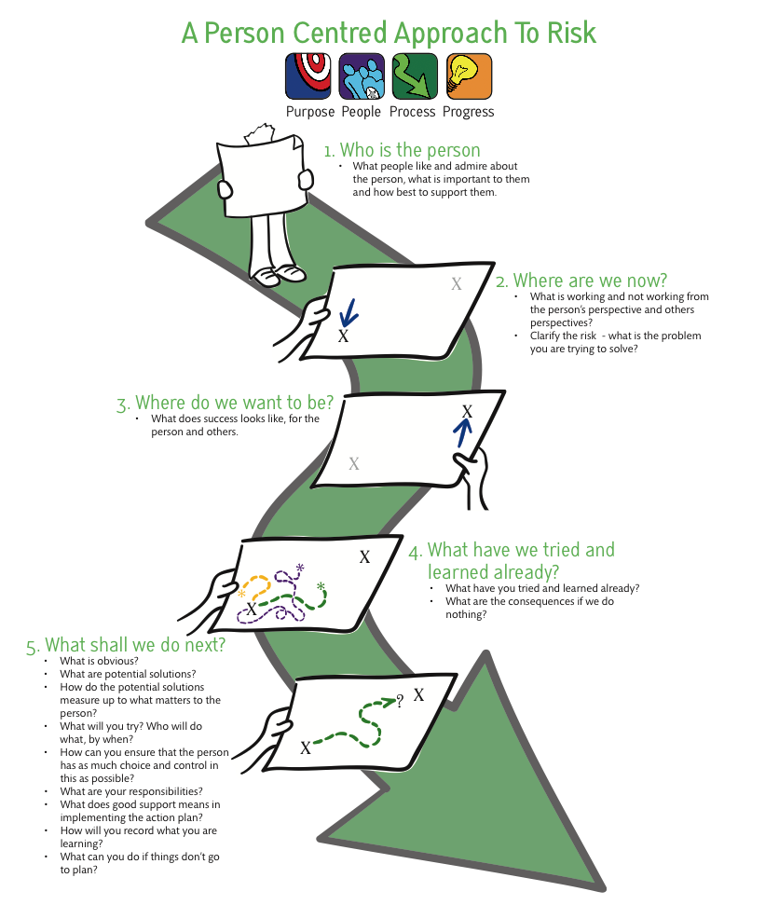

Slide 43
Grey’s Anatomy Video

Slide 44
2 Minute Drill
Imagine…
You have just been hired by a company that prides itself in supporting its employees.
They want to know the key things that you find helpful to be a productive employee.
You want to give them an overview, a summary in 2 minutes, of what they need to know to support you successfully.
What would you say?
© TLCPCP 2019 www.tlcpcp.com
Notes:
Group activity – 1 person in the group talks for 2 minutes – others listen attentively and gather info about them.
8 minutes total –
Choose person – 1 minute
Talk for 2 mintues
5 minutes to debrief as a group – how much info was learned, what kind of info was shared, etc.
TLC-PCP www.learningcommunity.us

Slide 45
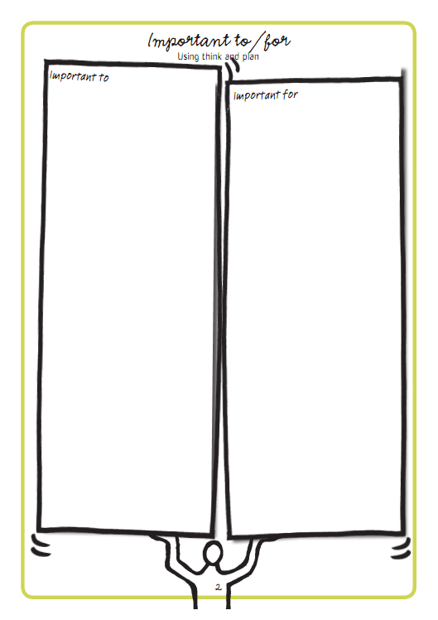
Activity
What is important to you and important for you at work?
Notes:
Individual activity – 10 minutes
Get people to report back on some of the things they added to their important to and important for. Ask for Important to first. Then ask for important for.
e

Slide 47
This is an awareness test…
Monkey Business Video
Notes:
Use chat

Slide 48
Harry
What is important to Harry | What is important for Harry
What else do we need to learn or know?
© TLCPCP 2019 www.tlcpcp.com
Notes:
10 minutes as a group activity. Can do in their course book or paper, etc. Reporters share, one piece at a time in Chat

Slide 49
Harry – Possible Answers
What is important to Harry | What is important for Harry
To attract women To spend his money as he wants To know what George thinks (his opinion) | To learn what to wear that will cause minimal pain and embarrassment To learn to manage his money
What else do we need to learn or know? What does Harry understand about – Managing his money Attracting women, dating Where it is appropriate to wear what
© TLCPCP 2019 www.tlcpcp.com

Slide 50
Moving from Service Life to Community Life
Service
Life
A Good Paid
Life
Community Life
‘Important to’ recognized
Focus on connecting,
building relationships
and natural supports
‘Important to’ present
‘Important for’ addressed
No organized effort to address ‘important to’
‘To’ and ‘for’ present
Closest people are
paid or family
Few real connections
‘To’ and ‘for’ present
Recognized for their contributions and valued participation
Are known and welcomed
© TLCPCP 2019 www.tlcpcp.com

Slide 51
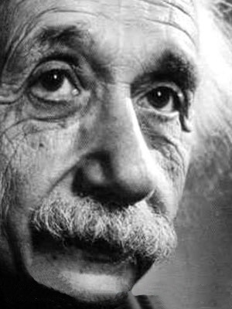
“If I had an hour to save the world, I’d spend 55 minutes defining the problem.”
© TLCPCP 2019 www.tlcpcp.com

Slide 54
Harry – George’s doughnut
Core
responsibilities
Use judgment
and creativity
Not our paid
responsibility
© The Learning Community for Person centred Practices, Inc. 2008
Notes:
Group activity – 10 minutes.
Come back as a group, share their answers, one column at a time in Chat. Debrief as a group.

Slide 55
Harry – George’s doughnut
Core
responsibilities
To help Harry make
an informed choice –
About the shirt
About his money
It starts with asking
why he wants
the shirt
Use judgment
and creativity
What you do/try
to help Harry make
an informed choice
about –
The odds against
the shirt being a
“chick magnet”
Spending ½ his money
for 2 weeks on
1 purchase
Not usually our
responsibility
Whether or not
he buys the shirt.
© TLCPCP 2019 www.tlcpcp.com
Notes:
Share.

Slide 56
Practical application
Important To / Important For and balance
Look for opportunities to use this tool to learn more about a situation, especially when people seem on different pages
Choice and boundaries
Pay attention to how you present choice to someone and if/how you promote choice and control
Two-minute drill
Find an opportunity to use this tool to learn something new about how to best support someone – maybe ask the person, a family member, another worker, etc.
The Doughnut
Look for an opportunity to use the doughnut to bring clarity about core responsibility in supporting someone and where/when a DSP can use judgement and creativity
Notes:
Activity – 8 minutes total (about 1 minutes each for introductions)
introduce themselves
1 thing they are passionate about (hobby, interest) choose roles for activities today

