Slide 2
2 Minute Drill
Imagine…
You have just been hired by a company that prides itself in supporting its employees.
They want to know the key things that you find helpful to be a productive employee.
You want to give them an overview, a summary in 2 minutes, of what they need to know to support you successfully.
What would you say?
© TLCPCP 2019 www.tlcpcp.com
Notes:
Group activity – 1 person in the group talks for 2 minutes – others listen attentively and gather info about them.
8 minutes total –
Choose person – 1 minute
Talk for 2 mintues
5 minutes to debrief as a group – how much info was learned, what kind of info was shared, etc.
TLC-PCP www.learningcommunity.us

Slide 3
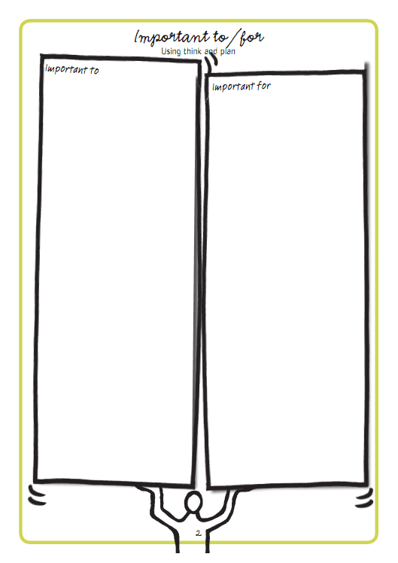
Activity
What is important to you and important for you at work?
Notes:
Individual activity – 10 minutes
Get people to report back on some of the things they added to their important to and important for. Ask for Important to first. Then ask for important for.
e

Slide 5
This is an awareness test…
Notes:
Use chat

Slide 6
Harry
What is important to Harry | What is important for Harry
What else do we need to learn or know?
© TLCPCP 2019 www.tlcpcp.com
Notes:
10 minutes as a group activity. Can do in their course book or paper, etc. Reporters share, one piece at a time in Chat

Slide 7
Harry – Possible Answers
What is important to Harry | What is important for Harry
To attract women To spend his money as he wants To know what George thinks (his opinion) | To learn what to wear that will cause minimal pain and embarrassment To learn to manage his money
What else do we need to learn or know? What does Harry understand about – Managing his money Attracting women, dating Where it is appropriate to wear what
© TLCPCP 2019 www.tlcpcp.com

Slide 8
Moving from Service Life to Community Life
Service
Life
A Good Paid
Life
Community Life
‘Important to’ recognized
Focus on connecting,
building relationships
and natural supports
‘Important to’ present
‘Important for’ addressed
No organized effort to address ‘important to’
‘To’ and ‘for’ present
Closest people are
paid or family
Few real connections
‘To’ and ‘for’ present
Recognized for their contributions and valued participation
Are known and welcomed
© TLCPCP 2019 www.tlcpcp.com

Slide 9
“If I had an hour to save the world, I’d spend 55 minutes defining the problem.”
© TLCPCP 2019 www.tlcpcp.com

Slide 12
Harry – George’s doughnut
Core
responsibilities
Use judgment
and creativity
Not our paid
responsibility
© The Learning Community for Person centred Practices, Inc. 2008
Notes:
Group activity – 10 minutes.
Come back as a group, share their answers, one column at a time in Chat. Debrief as a group.

Slide 13
Harry – George’s doughnut
Core
responsibilities
To help Harry make
an informed choice –
About the shirt
About his money
It starts with asking
why he wants
the shirt
Use judgment
and creativity
What you do/try
to help Harry make
an informed choice
about –
The odds against
the shirt being a
“chick magnet”
Spending ½ his money
for 2 weeks on
1 purchase
Not usually our
responsibility
Whether or not
he buys the shirt.
© TLCPCP 2019 www.tlcpcp.com
Notes:
Share.

Slide 14
Practical application
Important To / Important For and balance
Look for opportunities to use this tool to learn more about a situation, especially when people seem on different pages
Choice and boundaries
Pay attention to how you present choice to someone and if/how you promote choice and control
Two-minute drill
Find an opportunity to use this tool to learn something new about how to best support someone – maybe ask the person, a family member, another worker, etc.
The Doughnut
Look for an opportunity to use the doughnut to bring clarity about core responsibility in supporting someone and where/when a DSP can use judgement and creativity
Notes:
Activity – 8 minutes total (about 1 minutes each for introductions)
introduce themselves
1 thing they are passionate about (hobby, interest) choose roles for activities today

