Slide 1
balance
to
for

Slide 2
Balance means

Slide 3
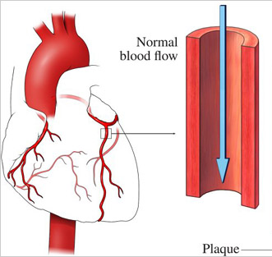
Julie’s balance
balance

Slide 4
Choice and Balance
As we think about choice, we can see
- All choice can be irresponsible (happy and dead)
- And dictating lifestyle is unacceptable (alive and miserable)
Good support means finding the balance
- Finding the balance can create conflict
- We all have a right to make choices, even bad choices
© TLCPCP 2019 www.tlcpcp.com

Slide 5
Breakout rooms
Facilitator
Keep things moving
Remind of 1 person at a time
Encourage everyone to participate
Timekeeper
Keep eye on the clock and give people reminders of how much time is left.
When using timed rounds, let people know when their time is about to end
Recorder/Reporter
Keep notes for the group – point form is fine
Report back to larger group – either verbally or in Chat based on request

Slide 6
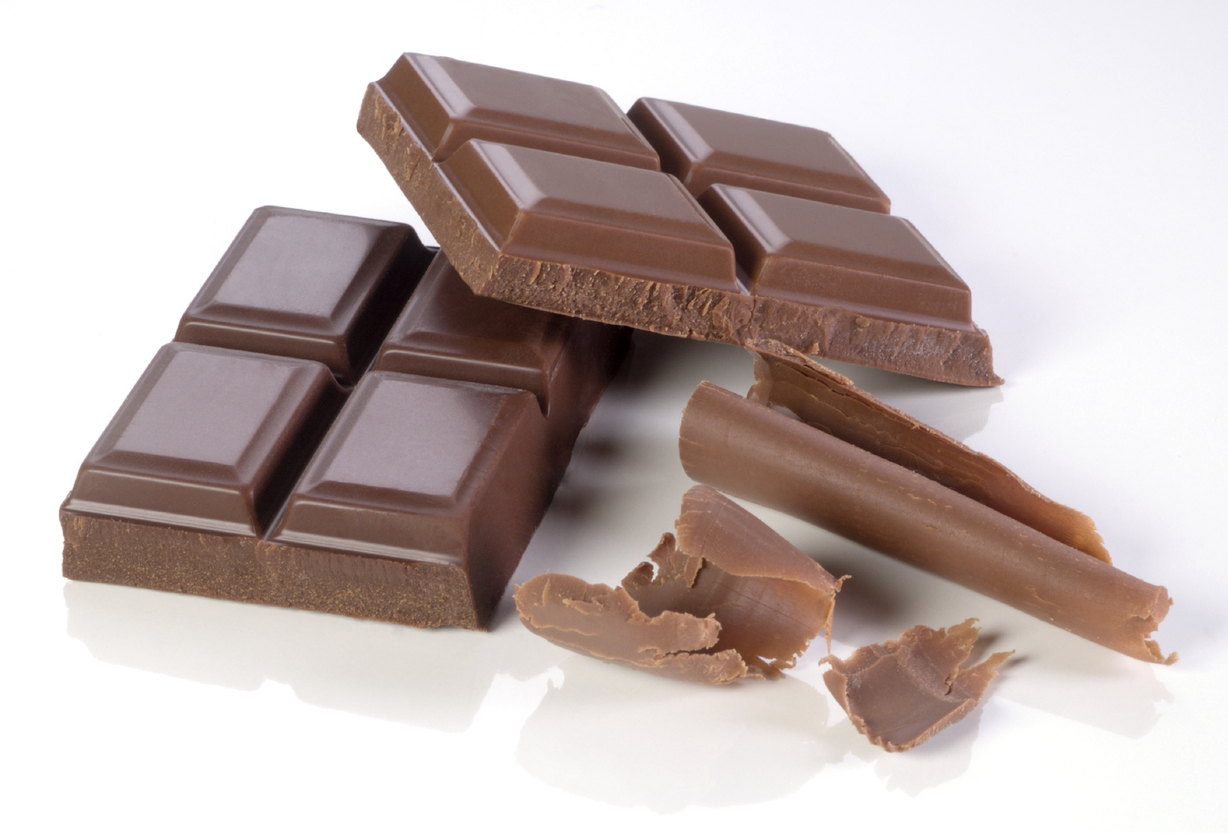
What are you struggling to balance?
Notes:
6
Group activity – 8 minutes

Slide 7
Control of the “W’s”
The Person has positive control over the “w’s”
What, Where, When, Why and With whom
The Person decides the “how”
© TLCPCP 2019 www.tlcpcp.com

Slide 8
Choice
A Key to Positive Control
Choice is not picking between two options (this or that)
Choice has limitations and impact (understanding them)
The person must find the options appealing to them
Adapted from TLCPCP 2019 www.tlcpcp.com
Notes:
TLC-PCP www.learningcommunity.us

Slide 9
Choice has Boundaries for Everyone
Imposed by society
Laws
Expectations/values
My values
What is and is not OK for me and those I trust
Ripple effect - One choice creates boundaries on other choices
My relationships
The work I do
Where I live
Resource Driven
Financial – how much time or money I have available
Risk involved
The difference is when the boundaries are set for the convenience of the system therefore limiting choices that meet the person’s desires: Operating hours, staff available, policies or procedures.
© TLCPCP 2019 www.tlcpcp.com

Slide 10
Support vs Overprotecting

Slide 11
Of course, some risk is just not okay

Slide 12
