Slide 1

Person-Centred Approaches
Session 2

Slide 2
Practical application
Important To / Important For and balance
Look for opportunities to use this tool to learn more about a situation, especially when people seem on different pages
Choice and boundaries
Pay attention to how you present choice to someone and if/how you promote choice and control
Two-minute drill
Find an opportunity to use this tool to learn something new about how to best support someone – maybe ask the person, a family member, another worker, etc.
The Doughnut
Look for an opportunity to use the doughnut to bring clarity about core responsibility in supporting someone and where/when a DSP can use judgement and creativity
Notes:
Activity – 8 minutes total (about 1 minutes each for introductions)
introduce themselves
1 thing they are passionate about (hobby, interest)
choose roles for activities today

Slide 3
Moving from Service Life to Community Life
Service
Life
A Good Paid
Life
Community
Life
‘Important to’ recognized
Focus on connecting,
building relationships
and natural supports
‘Important to’ present
‘Important for’ addressed
No organized effort to address ‘important to’
‘To’ and ‘for’ present
Closest people are
paid or family
Few real connections
‘To’ and ‘for’ present
Recognized for their contributions and valued participation
Are known and welcomed
© TLCPCP 2019 www.tlcpcp.com

Slide 4
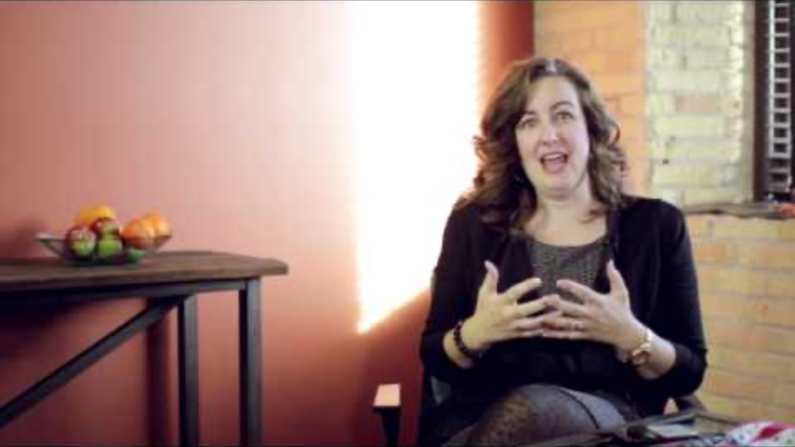
What is Community?

Slide 5
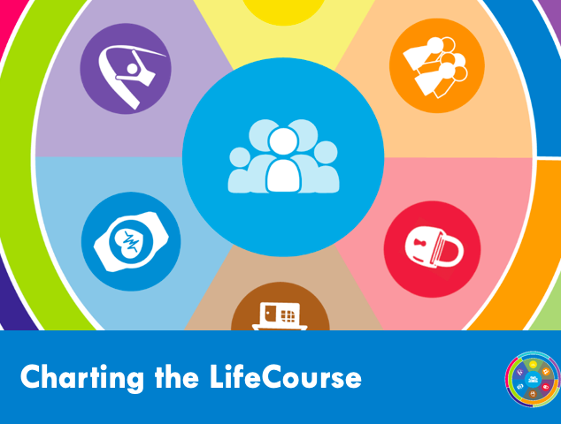
Notes:
The Charting the LifeCourse Framework was created by families to help individuals and families of all abilities and all
ages develop a vision for a good life.
The Charting the LifeCourse Framework supports the core belief that ALL people and their families have the right to
live, love, work and play and pursue their life aspirations in their communities.
The Charting the LifeCourse Framework can be applied to any situation, in any setting and used by ALL people.
Charting the LifeCourse Framework assists people and their families in planning and creating a vision for the future.
It is designed to help people think about the questions to ask as well as the choices and options to consider as they
plot a course to a full and meaningful life. It is intended to be a starting point no matter where a person is in their
life journey.

Slide 6
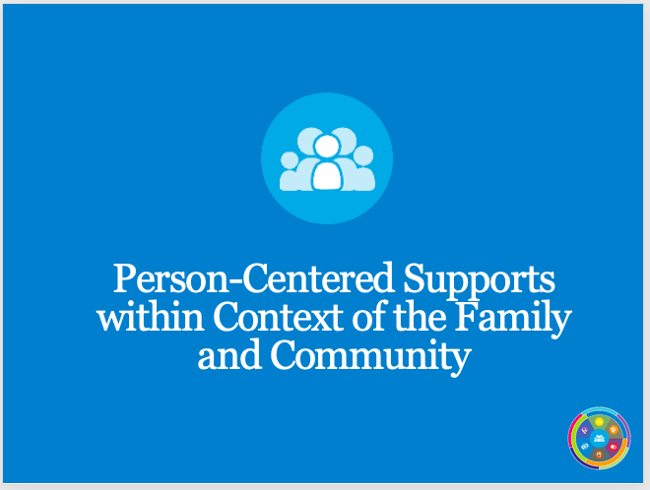
Notes:
This is not……. Family involvement VS person centered. Sometimes people get the impression that we have to do
one or the other -- plan with the person or plan for the person -- with the family.
Family Engagement is a component of a holistic approach to person centered supports that recognizes the context
and impact of the family in practice and policy implementation.
The focus is on the “person with a disability”
This does NOT mean that “Family Engagement” supersedes the INDIVIDUAL

Slide 7
Vision & Trajectory for a Good Life
Friends, family,
enough money,
job I like, home, faith, vacations, health, choice, freedom
Trajectory towards Life Outcomes
Vision of What I Don’t Want
Trajectory towards things unwanted
Notes:
. What you’re looking at now is another tool that is especially helpful in assisting us in capturing information that
people and their families might share with us during our interactions with them.
A trajectory helps us in determining life outcomes and a vision for a good life. It helps us balance decision-making
based upon what we want or what we don’t want – short term and long term. Plotting out our trajectory can help
us stay on our path to a good life.
The trajectory also helps us see the long-term consequences of life experiences. It helps us with advocating and
identifying why we want or need certain things in our lives.

Slide 8
Breakout rooms
Facilitator
Keep things moving
Remind of 1 person at a time
Encourage everyone to participate
Timekeeper
Keep eye on the clock and give people reminders of how much time is left.
When using timed rounds, let people know when their time is about to end
Recorder/Reporter
Keep notes for the group – point form is fine
Report back to larger group – either verbally or in Chat based on request
Notes:
15 minutes
Think of a time when you were knocked off your trajectory of a good life, or your vision was not being realized
How did it feel?
What decisions needed to be made to get back on track?

Slide 9






Person’s Perspective
Trajectory towards Good Life
I want to live in my own place,
Have a girlfriend/boyfriend,
Get married, A job
Work in a place where I’m not made fun of,
Friends, Make my own decisions
Trajectory towards Life Outcomes
Vision of What I Don’t Want
Drama, To be bossed around,
Made fun of,
Called the “R” word, Bullied
©UMKC Institute for Human Development lifecoursetools.com
Notes:
When we ask people with disabilities to describe or tell us what their vision of a Good Life is, they tell us…..
• I want to live in my own place
• Have a girlfriend/boyfriend
• Get married
• A job
• Work in a place where I’m not made fun of
• Friends
• Make my own decisions
When we ask people with disabilities to describe what they don’t want, they’ve told us……..
Drama
• To be bossed around
• Made fun of
• Called the “R” word
• Bullied

Slide 10
Family’s Perspective
Trajectory towards Good Life
I want them to be happy
Safe
Someone who loves them other than family
Friends
Trajectory towards Life Outcomes
Vision of What I Don’t Want
Them taken advantage of:
Emotionally, sexually, financially
Made fun of/bullied
Them to be Lonely
Living in Poverty
Institutionalized
©UMKC Institute for Human Development lifecoursetools.com
Notes:
When we’ve asked family members to describe or tell us what their vision of a Good Life is, this is what they tell
us….. (review the information on the slide)
When we’ve asked family members to describe what they don’t want, they’ve told us……..

Slide 11
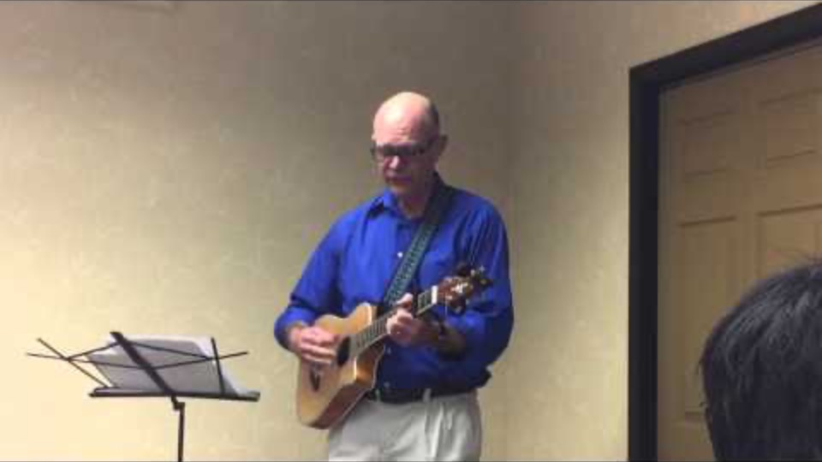
3 times a week

Slide 12
Harry continued

Slide 13
Harry #2 – new information
What is important to Harry | What is important for Harry
What else do we need to learn or know?
© TLCPCP 2019 www.tlcpcp.com

Slide 14
Breakout rooms
Facilitator
Keep things moving
Remind of 1 person at a time
Encourage everyone to participate
Timekeeper
Keep eye on the clock and give people reminders of how much time is left.
When using timed rounds, let people know when their time is about to end
Recorder/Reporter
Keep notes for the group – point form is fine
Report back to larger group – either verbally or in Chat based on request

Slide 15
Harry #2 – add new information
What is important to Harry | What is important for Harry
To be around this woman, have her “recognize” that she wants him. To have control and power over her. | To know the legal consequences of stalking To stop stalking To understand that stalking doesn’t work to get an intimate relationship
What else do we need to learn or know? More about the past history of this or similar behaviour? How dangerous is he? Does he get what we think he gets out of stalking? Has he ever had a “regular adult” relationship?
© TLCPCP 2019 www.tlcpcp.com

Slide 16
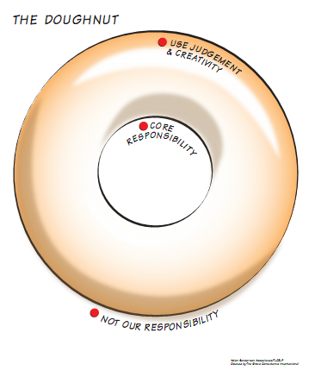

Slide 17
Harry #2 – Executive Director’s doughnut
Core
responsibilities
Use judgment
and creativity
Not our paid
responsibility
© TLCPCP 2019 www.tlcpcp.com

Slide 18
Breakout rooms
Facilitator
Keep things moving
Remind of 1 person at a time
Encourage everyone to participate
Timekeeper
Keep eye on the clock and give people reminders of how much time is left.
When using timed rounds, let people know when their time is about to end
Recorder/Reporter
Keep notes for the group – point form is fine
Report back to larger group – either verbally or in Chat based on request

Slide 19
Harry #2 – Executive Director’s doughnut
Core
responsibilities
Short term -Keep the
woman safe and in
the process keep him
safe (and out of jail)
Longer term – teach
relationship SKILLS,
figure out why he is
stalking, any pattern,
and deal with it,
seeking a way for
Harry to live safely
in the community
Use judgment
and creativity
Short term – How
you keep the woman
safe until you can get
him treatment
Longer term – how
you learn, acting on
what you learn,
figuring out how he
can get what is
important enough to
him that that he
will participate in
treatment
Not usually our
responsibility
To help him get
sex or keep him out
of jail at all costs
© TLCPCP 2019 www.tlcpcp.com

Slide 20
Personal Reflection
How could I use these tools in my work?

Slide 21
Moving from Service Life to Community Life
Service
Life
A Good Paid
Life
Community
Life
Harry
‘Important to’ recognized
Focus on connecting,
building relationships
and natural supports
‘Important to’ present
‘Important for’ addressed
No organized effort to address ‘important to’
‘To’ and ‘for’ present
Closest people are
paid or family
Few real connections
‘To’ and ‘for’ present
Recognized for their contributions and valued participation
Are known and welcomed
© TLCPCP 2019 www.tlcpcp.com
Notes:
Remind participants of the Service Life to Community Life continuum. How would the proposed actions
suggested by the group for Harry, Bob or personal stories affect where the person is on the continuum?
Ask if this is a helpful way to think about proposed actions in their work.
Then move to the next slide and tell the rest of the story.

Slide 22
Moving from Service Life to Community Life
Service
Life
A Good Paid
Life
Community
Life
Harry
Focus on connecting,
building relationships
and natural supports
‘Important to’ recognized
‘Important to’ present
‘Important for’ addressed
No organized effort to address ‘important to’
‘To’ and ‘for’ present
Closest people are
paid or family
Few real connections
‘To’ and ‘for’ present
Recognized for their contributions and valued participation
Are known and welcomed
© TLCPCP 2019 www.tlcpcp.com
Notes:
Harry – if you start imposing 24hrs/day supervision, taking his phone away, etc. – Harry would move from
a community life to a paid life.

Slide 23
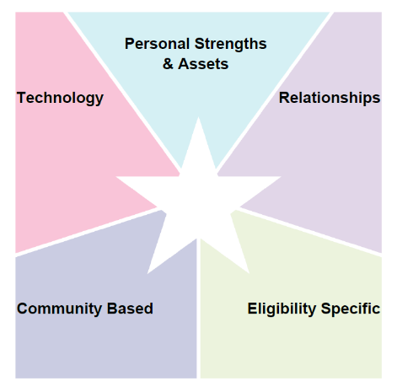
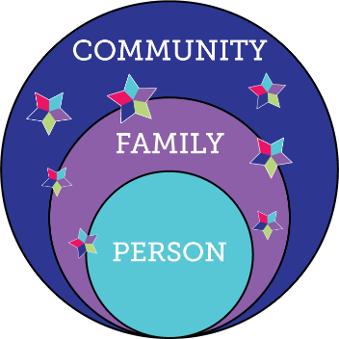

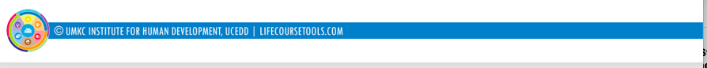
Integrated Support Star
What We Want To See…
resources, skills, abilities
i-pad,computer,
smart phone apps, remote monitoring, cognitive accessibility,
Adaptive
equipment
family, friends, neighbors, co-workers, church members, community members
school, businesses, church faith based, parks & rec, public transportation
SHS services, Special Ed, Medicaid, Voc Rehab, Food Stamps, Section 8
R
100%
Notes:
The second principle that we want to share with you is the Integrated Support Star. In the past, conversations about
supporting people with disabilities and their families mainly revolved around the supports offered by the disability
service system. We are trying to help families as well as organizations and policymakers understand that we ALL
access a variety of supports to make it through our daily lives.
We ALL do this routinely without thinking about it. We automatically brainstorm about other supports that are
available to us.
• Personal Strengths & Assets - What can we do on our own? What do we bring to the table? What do we
want to learn or could learn?
• Technology - Is there some type of technology available that can help us?
• Relationships - Who do we know that might be able help?
• Community Based - Where can we get support just like anyone else does - within our own community?
• And we also use eligibility specific supports.
What we WANT to get to is the circles on the left, where we all exist in the context of our families and communities.
And where the person receives lots of different kinds of supports, represented by the stars. But only where and
when supports are needed. This should happen regardless of whether or not a person is eligible for paid supports.
We want to encourage individuals and their families to think about all areas of the Integrated Support Star when
planning.
It’s something we all do. This is how we get the supports needed for a GOOD LIFE!!

Slide 24
Notes:
We shouldn’t put all of our eggs in one basket, nor should we rely on just one part of the star.
For example, if all the reliance is on the family to support the trajectory to the good life vision the person nor their
family has rich fulfilling lives. We should also think about…what if the family is no longer in the picture or no longer
able to provide support?
Only relying on paid services to get a person their good life doesn’t work either. Think about what a totally - service
life would do to a person’s trajectory. It would give them a paid life. Maybe a good paid life, but a paid life none the
less.

Slide 25
The support sequence
Notes:
We often tend to go to paid services/hours as the first option for supports. We need to flip this on its head and look
at most inclusive options and options that promote self-determination first, other community options then and
finally, eligibility services.

Slide 26
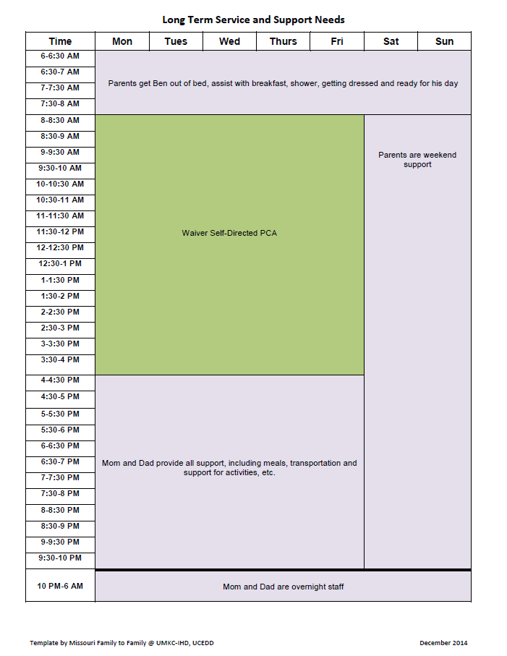
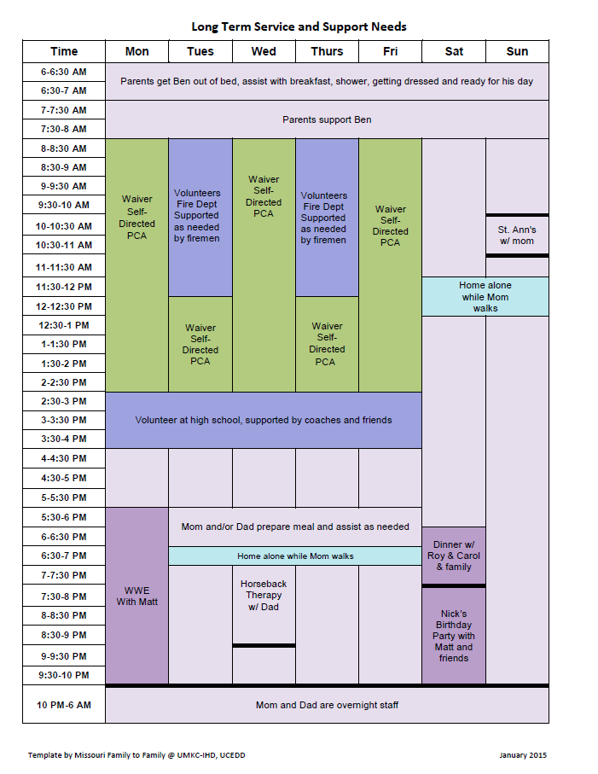
Integrated Supports
Paid supports
Notes:
Ben is someone who lives with his family and receives Family Support Services. Notice on the left what his life was
like before using the Integrated Support Star. After the Star, see what other resources are available to him.
Ben’s parents were very intentional in using the integrated support star to look at other types of supports. They
wanted Ben to be more independent and have more connections. Another thing to share with participants is that
they should notice that Ben’s “paid services” weren’t reduced. Ben and his family just used his services differently
in order to make them work better for Ben and the family. Telling folks this helps them to understand that using
Charting the LifeCourse doesn’t mean we’re going to cut or reduce “paid system services.”

Slide 27
Ben’s integrated supports

Slide 28
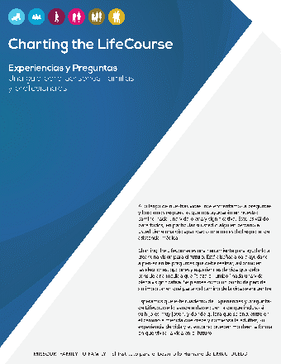

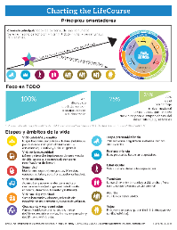
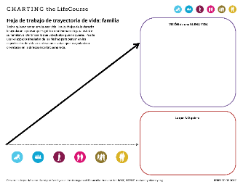
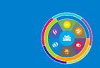
Charting the LifeCourse Framework and Tools
Charting the LifeCourse Resources:
Find CtLC webinars, resources and tools on lifecoursetools.org
Learn from others who are using CtLC on the Facebook Group: Charting the LifeCourse in Action
Follow the latest updates or opportunities on the Facebook page: lifecoursetools.com
Attend the Annual Charting the LifeCourse Showcase for 2 days of learning and sharing in Kansas City, MO
Connect with your state Community of Practice on Supporting Families team supportstofamilies.org
Contact umkcCtLC@umkc.edu for more information.
lifecoursetools.com

Slide 29
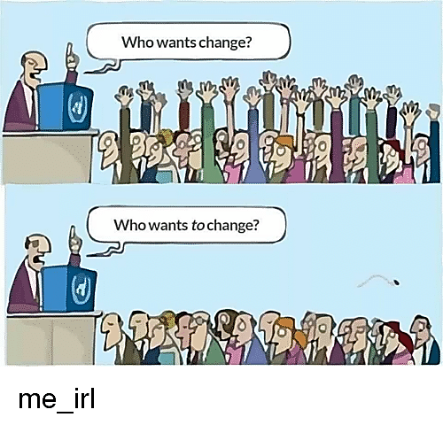
Change Agents AND Change Targets
© TLCPCP 2019 www.tlcpcp.com
Notes:
Change agent
We often see the need for change and encourage others to make needed changes. If we do this and don’t change
anything we do, we are known as Change Agent. We talk the talk but don’t walk the talk. We have all had
experience with people who do this.
Change target
Change is hard and as our system evolves it requires us to have and use a different skill set. We know skills must be
practiced in order to become good with them. We must become a Change Target and walk the talk. It will require
us to change our habits, how we respond to things, how we interact with others.
Debrief - Some questions might include:
• Where do you see opportunities to do our work differently? How will people develop the skills to accomplish
this?
• Where do you see challenges in making this happen? How can they be addressed?
• Where do you see yourself in accomplishing the changes?

Slide 30
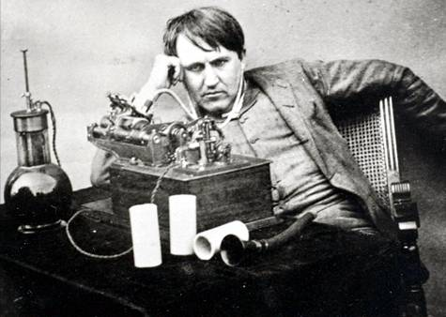
‘Discontent is the first necessity of progress’ -Thomas Edison
© TLCPCP 2019 www.tlcpcp.com

Slide 31
Discontent is the Engine of Change
There are 2 kinds of discontent
  Cynical discontent
  Optimistic discontent
© TLCPCP 2019 www.tlcpcp.com
Notes:
To systematically teach ourselves to think “the purpose of our efforts is to help people get better
lives”, requires change.
Changes must occur in how we think, what we pay attention to, what we do in response and what
we structure into our organizations and systems to support the changes desired. Change only
occurs where there is discontent. Happy people don’t change.
When we develop good descriptions of how people want to live and compare that with how they
are actually living, -the difference between the two that we see - and then hopefully feel- is the
discontent. But there are 2 kinds of discontent – optimistic and cynical. One can be helpful, one
can be destructive. It is our hope to create a sense of helpfulness with this training.

Slide 32
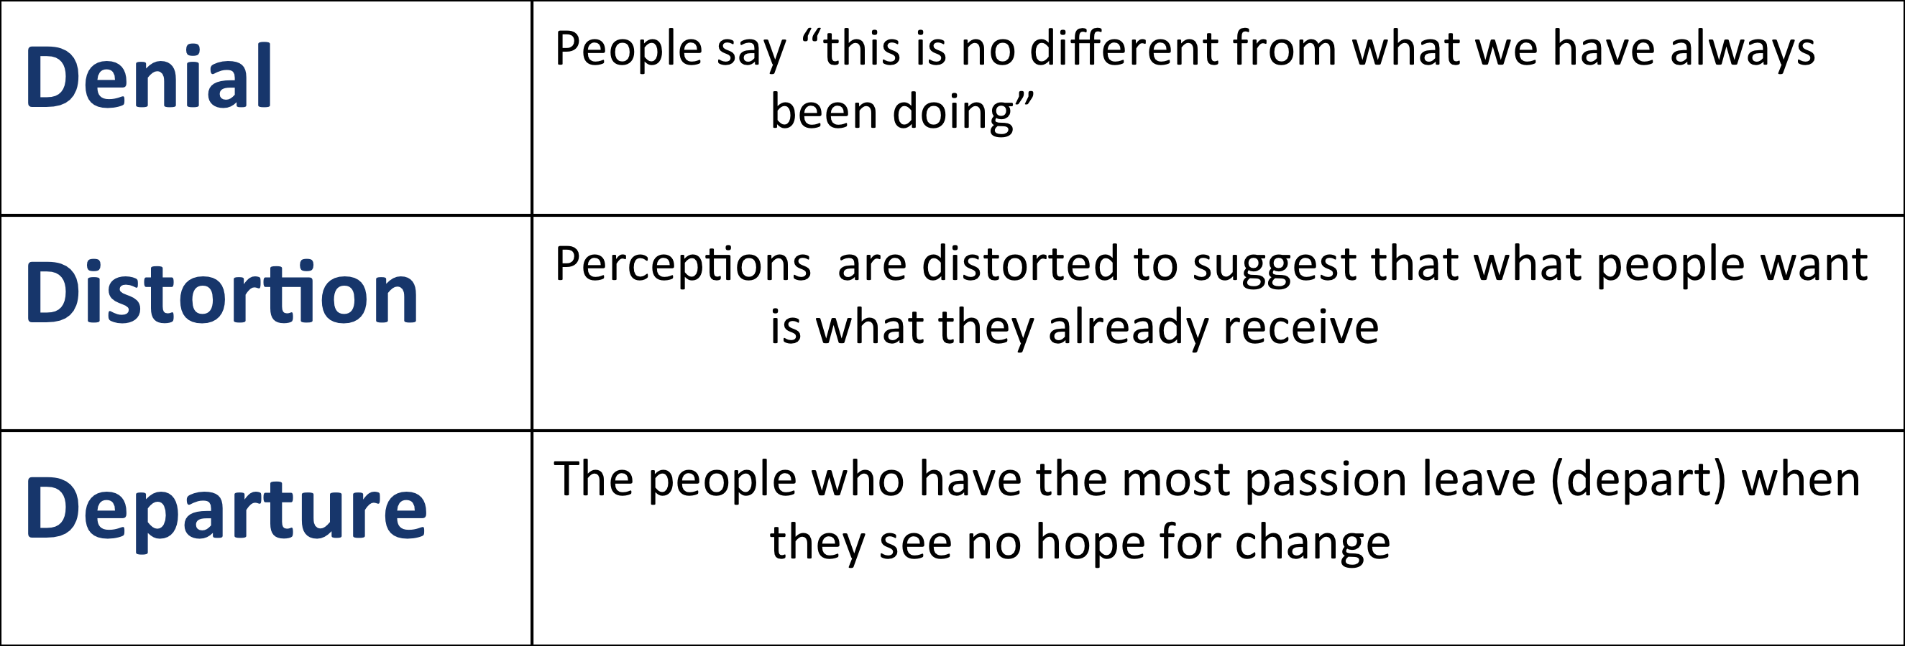
Cynical Discontent
  When you have discontent without hope
  you get cynical discontent which results in:
© TLCPCP 2019 www.tlcpcp.com
Notes:
Cynical discontent is endemic in our work. Every time we introduce a new practice, we are also making a promise;
any time we don’t follow through we have broken that promise. We create and reinforce cynical discontent. You
have over-promised & underdelivered.
If cynical discontent is present, you will see 1 of the 3 “Ds” – denial, distortion or departure –
•It is no different from what we have always been doing
•People are happy with what we are doing – change is not needed
•The people with passion leave
Here’s an example:
Have you ever worked someplace and saw something wasn’t working well? You have a solution and bring it to your
supervisor, and he/she says:
I don’t know what you’re talking about. We don’t have any problem here (denial)
Or maybe he/she says: Well everybody likes how we do this. I don’t understand why you don’t (distortion)
How many of you get tired of banging your head against the wall and decide to leave? (departure)
What happens to those supported if all the good people leave?

Slide 33
Optimistic Discontent
Requires hope based on trust that is created when there is:
A history of acting on things that can be changed
Honesty about those things that will take time to change
Progress in acting on the things that take time
Where cynical discontent is dominant
…trust must be created
© TLCPCP 2019 www.tlcpcp.com
Notes:
Provide an overview of the 3 points
• Optimistic discontent has to be nurtured
• it is rooted in trust and feeling empowered.
• When planning with people it is rooted in knowing that you can act on what you learn – in knowing that you
can reduce the gap between how the person wants to live and how that person is actually living.
• Optimistic discontent comes when you believe change can happen.
Now, let’s go back to that example, you are working someplace and have a solution to resolve an issue. This time
when you take it to your supervisor you hear: That’s a great idea, let’s see how we can make that happen.
Ask the group, how does that make you feel? (you will get answers such as valued, a part of things, happy, etc.)
So, you are waiting for things to change but don’t really see anything and start to become disillusioned. Your
supervisor comes to you and says: This is taking longer than we thought, but here is where we are with things.
Ask people, How does that make you feel? (you will get positive responses).
Let people know, if we are to build optimism there needs to be communication so people continue to be informed.
It builds trust (show next part of slide about building trust)
Let people know part of your role over the class is to create discontent and you hope that it will be optimistic
discontent.

Slide 34
Levels of Change
Any change that results in a positive difference in the lives of people who use services or in your own work life.
Level 1
Any changes an organization makes to it’s practices, structure or rules that result in positive differences in the lives of people.
Level 2
Any change in practice, structure and rules made at the system level. These changes have an effect on many organizations, and therefore many peoples’ lives.
Level 3
© TLCPCP 2019 www.tlcpcp.com
Notes:
Discontent leads to change and it is helpful to think about change as happening at several levels.
• Level one, you don’t need any permission to implement. Changes in such things as routines, rituals,
approach. These are changes that can be made immediately. Provide a Level One Change example (ex.
language is something we have control over, and do we use language that is respectful to people)
• Level two changes require approval from management. It is a change in practice, policy, or structure. The
need for Level two changes is best identified by having a structured way for the shared learning of direct
support level go to the organization’s leadership. Provide a Level Two Change example of something that has
occurred and impacted the organization (ex. changes to forms or job duties)
• Level three changes can be thought of as “systemic” changes. It can apply to the rules and regulations we
must follow. It can include how those rules are interpreted and the impact that has on monitoring/licensing.
A change in state law or regulation is an example of a level three change. Provide a Level Three Change
example (ex. CMS Final Rule for HCBS Services)

Slide 35
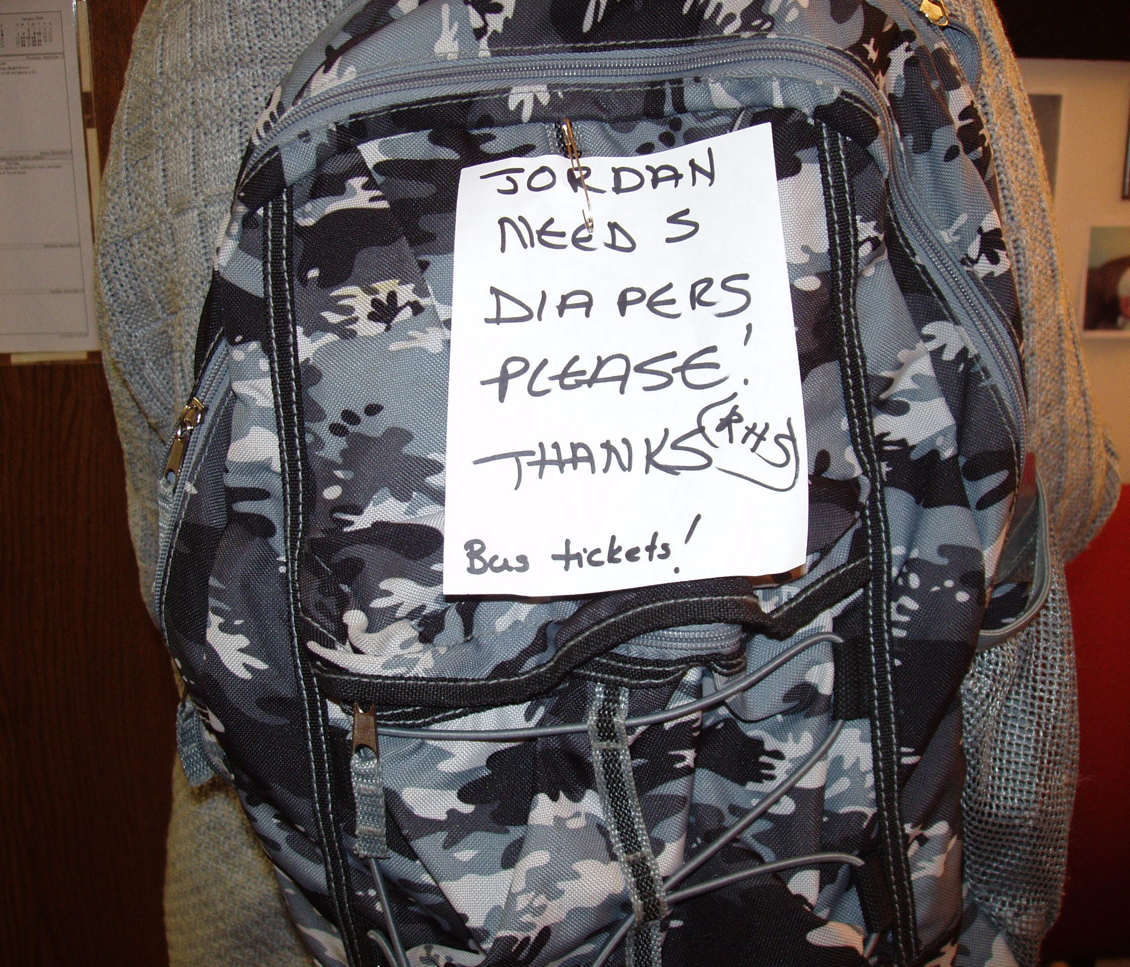
Notes:
Note on school bag example
Take a look at this; what do we see? This is a real picture. This happened to Jordan.
Describe what they see- and correct them if they are wrong.
Can we imagine that Jordan is returning home from school on the bus?
How could this be done differently? What actions could be done at each level of change?
- level one change: asking support staff to place notes in Jordan’s bag and not on the bag
- level two change: training about respect for staff, day program policy
-level three change: organizational policy, yearly training on how we share information and protect information,
training on respect and organizational values

Slide 36
Breakout rooms
Facilitator
Keep things moving
Remind of 1 person at a time
Encourage everyone to participate
Timekeeper
Keep eye on the clock and give people reminders of how much time is left.
When using timed rounds, let people know when their time is about to end
Recorder/Reporter
Keep notes for the group – point form is fine
Report back to larger group – either verbally or in Chat based on request

Slide 37
Practical application
Life Trajectory
Look for opportunities to use this tool – ask about what a good life looks like and what people don’t want
Pay attention to activities or situations that are leading people to lives they don’t want
Integrated Supports/ Support Sequence
Pay attention to paid supported being provided and ask yourself if they are really necessary and why?
Change
Look for opportunities to create or advocate for Level 1, 2 and 3 change

