Slide 1
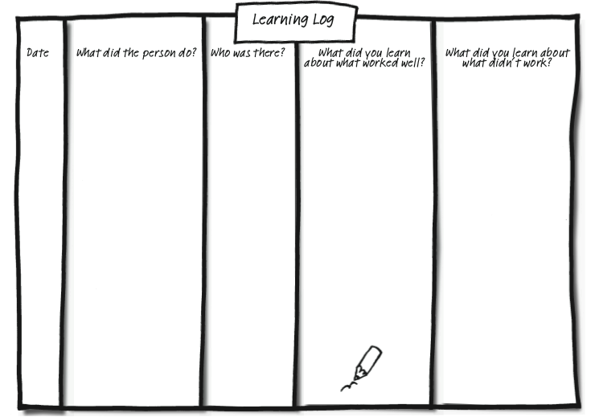
Capturing learning - Learning Log
© TLCPCP 2019 www.tlcpcp.com

Slide 2
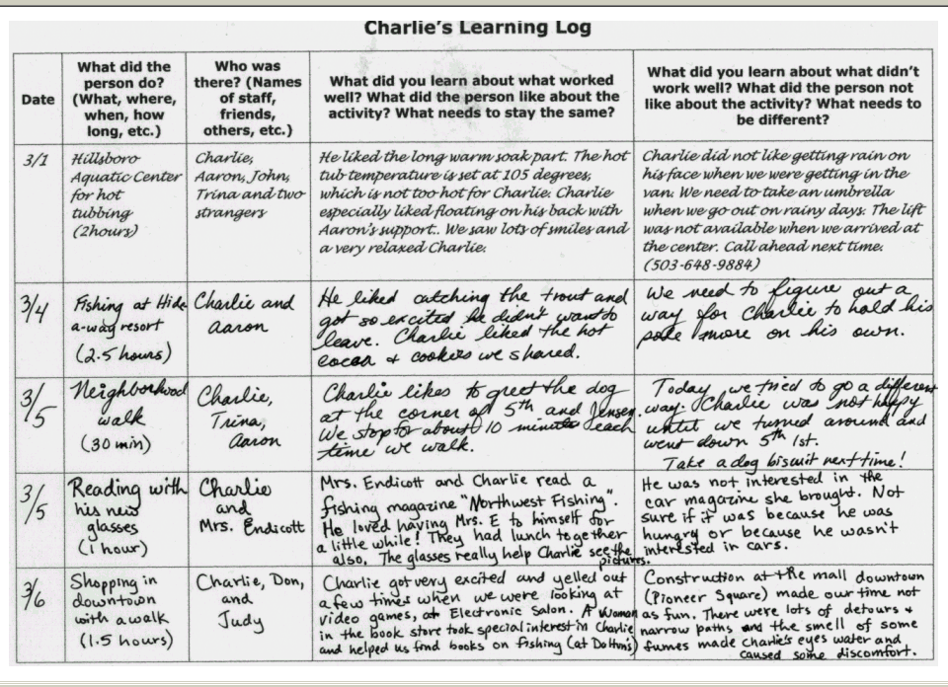
© TLCPCP 2019 www.tlcpcp.com

Slide 3
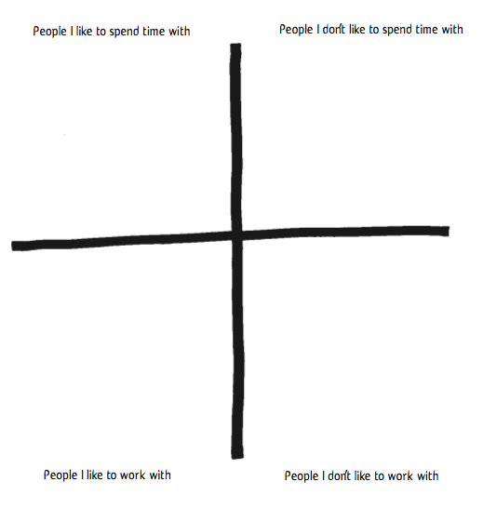
Characteristics of
Characteristics of
Characteristics of
Characteristics of
© TLCPCP 2019 www.tlcpcp.com

Slide 4
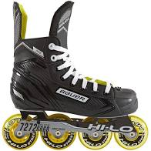
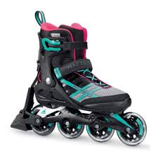
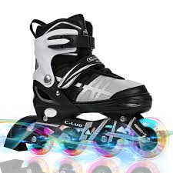

Slide 5
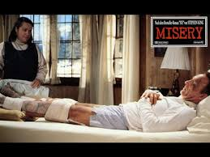
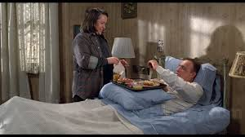
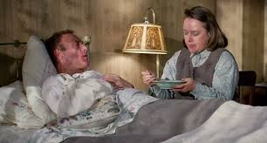
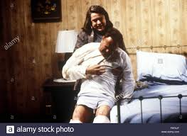

Slide 6
How would you feel?
What would you do?

Slide 7
Learning personality ‘characteristics’ that
need to be Present or Absent in supporters
To learn the characteristics that need to be present, ask: | To learn the characteristics that need to be absent, ask:
Who is closest to the person? Who enjoys spending time with the person? Who helps make good days happen for the person? What characteristics do these people have in common? | Who does the person avoid? Who dislikes spending time with the person? Who makes the person have bad days? What characteristics to these people have in common?
© TLCPCP 2019 www.tlcpcp.com

Slide 9
Matching Staff Supporting: Alan
Support wanted and needed | Skill needed | Personality Characteristics Needed | Shared Common interests (would be nice to have)
Able to get out of the Oldham area e.g. Blackpool, Southport | Full driving license Able to go on motorways To be a car driver | Patience/ Confident | They enjoy visiting places and travel
Someone who will take Alan fishing | Someone who can fish Can handle bait maggots worms | Someone who enjoys peace and quiet Someone who is patient Prepared to sit in the rain Not squeamish | Fishing Angling interest
Someone who can use computers | Basic IT Skills Able to problem solve | Able to share computer knowledge Willingness to learn | Enjoys going on the computer
Someone who enjoys going for a meal | Able to engage with Alan where he wants to go. Enjoys socializing | Someone who likes to go out and about Good communicator | Someone who enjoys a nice meal in a pub/restaurant/cafe

Slide 11
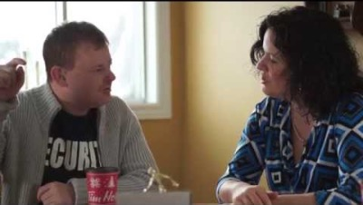
Person-Centred Reviews

Slide 12
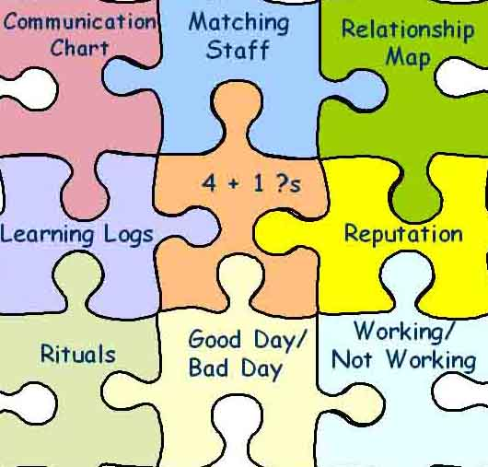
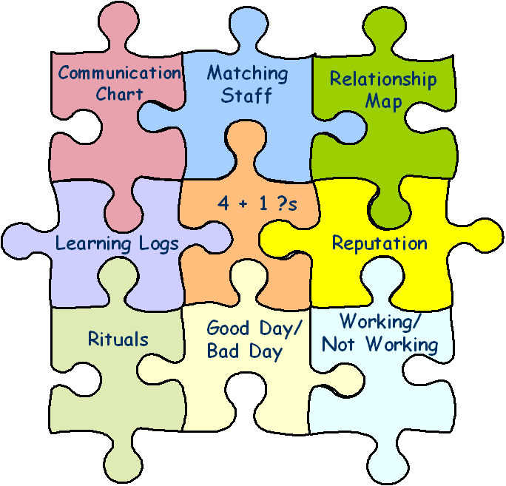
Learning Wheel
What needs to stay the same?
What needs to change?
WW / WNW
Person-Centred
Description
Action
Planning
PCT Tools
Implementation
& Learning
© TLCPCP 2019 www.tlcpcp.com

Slide 13
4 + 1
What have you tried? 1 | What have you learned? 2 | What are you pleased about? 3 | What are you concerned about? 4
What did you do? When did you do it? Who else was there? | What did you learn from your efforts? | What did you like about what you tried? What went well? What worked for you? | What challenges did you encounter? What didn’t you like about what you tried? What didn’t work for you?
+1 – Given your learning what will you do next?
?
?
© TLCPCP 2019 www.tlcpcp.com

Slide 14
What we have done to address Liz’s malnourishment
What have we TRIED? | What have we LEARNED? | What are we PLEASED ABOUT? | What are we CONCERNED ABOUT?
● Healthy frozen meals  Daughter cooking a week’s worth of food for her  High protein shakes 2x a day | She doesn’t like processed food Will almost always eat daughter’s home cooked food Protein shakes work really well  If she is having a really bad day, might only drink one shake at best | ● She is steadily gaining weight  Found at least two options that work for her  She is committed to eating when she can | Stress on daughter to cook and drive 5 hours round trip every weekend Only eating once a day Will lose appetite again if depression comes back
+1: Keep doing protein shakes; find someone local to cook occasionally; keep asking “what did you eat today, not just “did you eat today?”
© TLCPCP 2019 www.tlcpcp.com

Slide 15
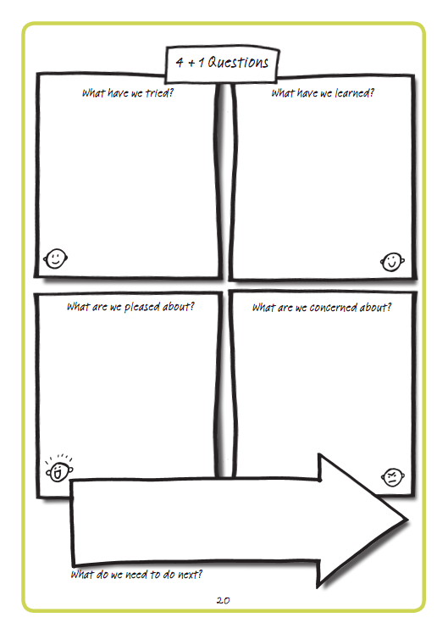

Slide 16
4 + 1
During our time together these last 2 days…
?
?
What have you tried? 1 | What have you learned? 2 | What are you pleased about? 3 | What are you concerned about? 4
+1 – Given your learning what will you do next?
© TLCPCP 2019 www.tlcpcp.com

Slide 17
© TLCPCP 2019 www.tlcpcp.com

Slide 18
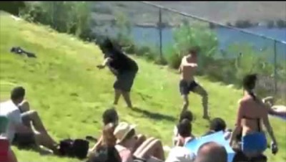
First follower

Slide 19

www.hsacanada.ca
or contact:
Barb Swartz-Biscaro
barbs@hsacanada.ca
1-705-753-5064

