Slide 1
Our Mantra for the Exercises
Guess: look at what your partner wrote and guess in your head
Ask: ask your partner if your guess is correct, have a conversation, not an interview!
Check: how would your partner phrase it, in their words?
Write: write down what you learn

Slide 2
Building a One Page Profile
Core Elements
What People
Like and
Admire about
the person
One Page
Profile

Slide 3

http://www.youtube.com/watch?v=MiLJucWsbgk

Slide 4
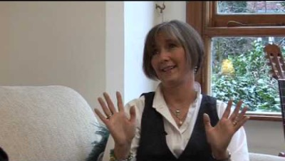

Slide 5

Reputation
Exercise

Slide 6
Reputation Exercise – Part 1
Divide a sheet of paper in half and write ‘Positive Reputation’ on the top-left side and ‘Negative Reputation’ on the top-right.
NEGATIVE REPUTATION
POSITIVE REPUTATION
  Write down 3 mild negatives, for example:
  Stubborn
  Directionally impaired
  Workaholic
© TLCPCP 2019 www.tlcpcp.com

Slide 7
Reputation Exercise – Part 2
For each negative, ask 3 questions:
Are there circumstances in which the negative is a positive?
If yes, add the like and admire (appreciation) section of the one-page profile.
Does the negative reflect something that is important to the person?
If yes, add it to the important to section of the one-page profile.
Is the negative sometimes a problem, If yes, what do other people need to know or do to support the person when it is a negative?
Add it to the how to best support section of the one-page profile.
© TLCPCP 2019 www.tlcpcp.com

Slide 8
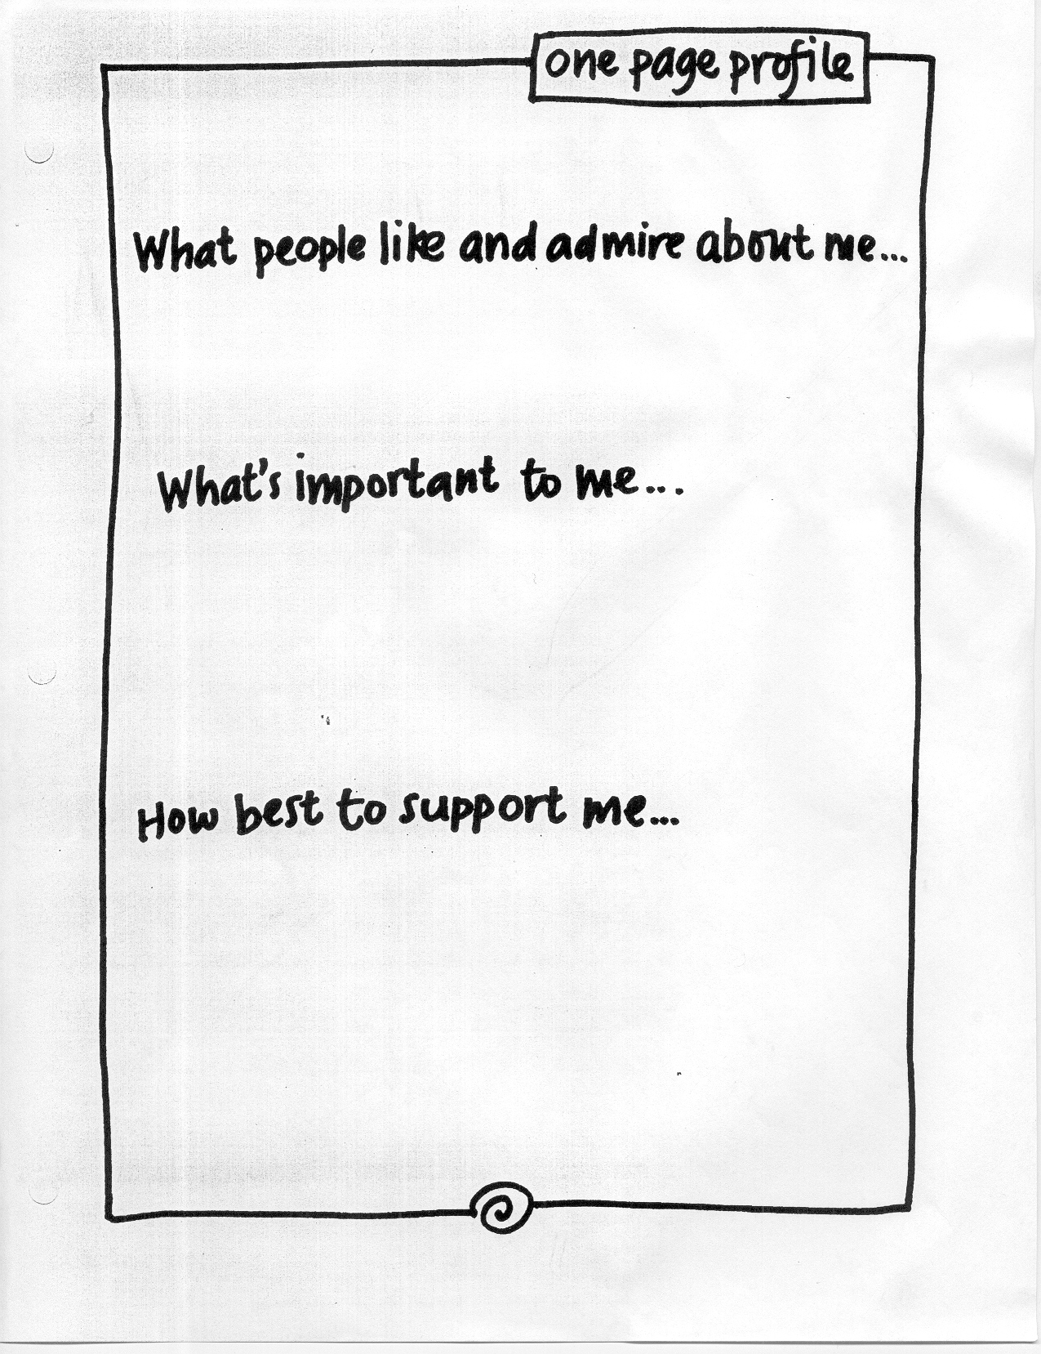
Is she stubborn or is it
something else?
Is the negative sometimes a positive for this person? i.e. is
the person sometimes simply
determined or showing perseverance?
Determined
I like doing things my way unless you can help me see the value in doing it differently.
Does it tell us something about what is important to her? i.e. What is she stubborn about?
When I’m tired, I’m sometimes
stubborn for no reason at all. Suggest that we can do the activity or have the conversation later.
Is she sometimes just being plain
old stubborn? If so, does she want support with this and what does that look like?

Slide 9
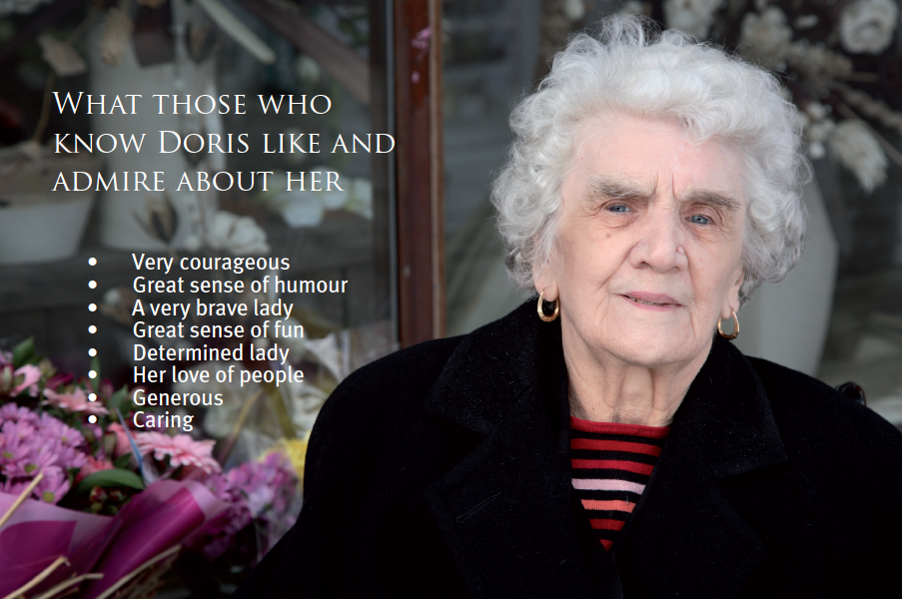

Slide 10
Use of Language
‘If thought can corrupt language , then language can corrupt thought.’
- George Orwell
a story…

Slide 11
Building a One Page Profile
Core Elements
One Page
Profile
Important To
the person
How to best
support
the person

Slide 12
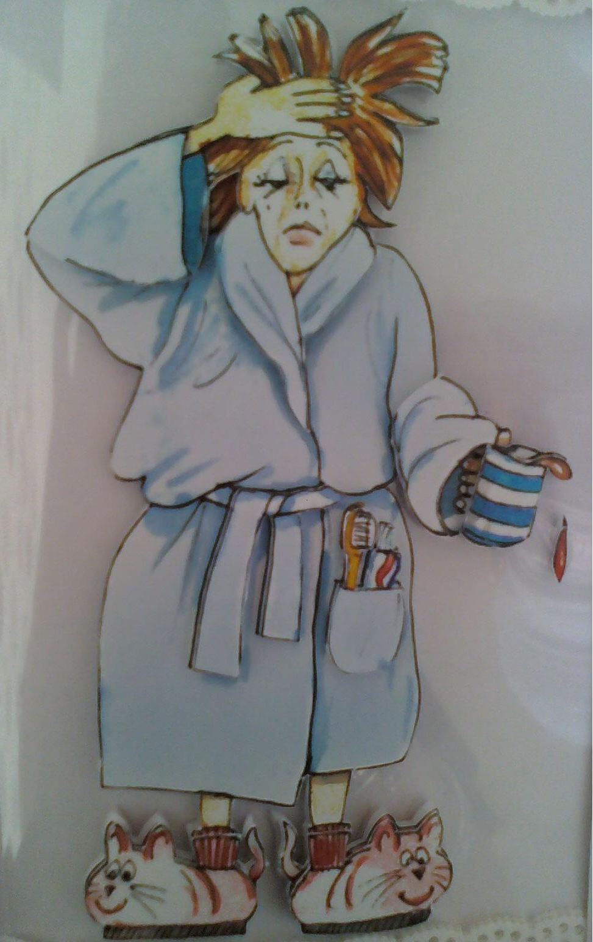

Morning Ritual

Slide 13
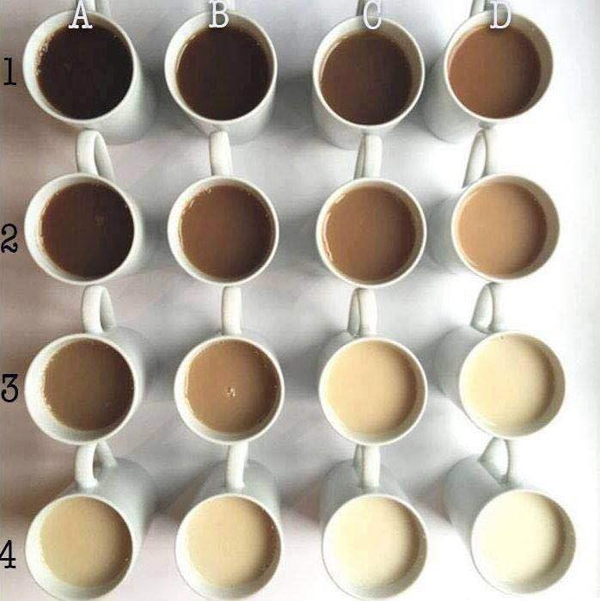

Slide 14
Barb’s Morning Ritual
5:30 am Mike gets up, turns on the tv, goes to the shower and makes coffee
5:45 am Mike comes back to bed with a coffee for each of us and watches tv while I snooze (he shakes me and reminds me coffee is beside my bed)
6:00 am Get another reminder that my coffee is getting cold
6: 30 am he gets another coffee and warms mine up – yet another reminder
7:00 am I wake up and watch half an hour of tv (news and weather on HLN) with Mike and drink my twice warmed coffee
7:30 am Get out of bed, say good morning to the dog, go to kitchen table to have another coffee and check my emails, social media, chat with the kids while they get ready to leave for the day
8:00 am say farewell to the last of the kids going out the door, put my walking clothes and fitbit on, Mike and I go for a n hour walk
9:00 am Get back from our walk and have a shower. Tresemme shampoo and conditioner, Neutrogena face wash, Neutrogena body wash, shave underarms everyday, legs every other day
9:10 am Get out of shower, use fluffy soft towel, brush hair, put on deodorant (secret gel), put on Neutrogena anti wrinkle face cream, take Vitamin D drops and medication
9:15 am go to my room and get dressed, if I have no meetings I dress in tights and t-shirts, if I have meetings I dress in work clothes
9:20 am go back upstairs, put hair mousse in, put makeup on, brush teeth (Crest 3-D white gel toothpaste) dry hair and flat iron, make some toast or grab an orange
9:30 am go to my office with another coffee and breakfast and start my work day

Slide 15
Rituals – Part 1
Write down your morning ritual
Include as much detail as you are comfortable with
Tell us how long it takes – indicate what time it starts and what time it ends
© TLCPCP 2019 www.tlcpcp.com
Notes:
This training focuses on how to gather information and how to use that to develop a 1st plan. Because this training skips the first step you need to help people notice what should happen. Emphasize that plans that work are always developed in partnership and that they always start with thinking about what you want to learn. The next slide has some of the questions that those who write plans should start with

Slide 16
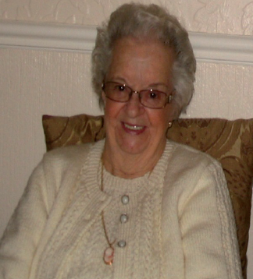
It was important to Joan to be able to stay in bed for 30 minutes after being woken in the morning so as she could say her prayers, we discovered that what wasn’t working for her was that this only happened when the staff who knew her well were on duty.

Slide 17
Other Rituals
Going to bed
Mealtimes
Transition
Birthday
Cultural/Holiday
Spiritual
Vacation
Comfort/health
Celebration
Mourning/grief/loss
© TLCPCP 2019 www.tlcpcp.com

Slide 18
© TLCPCP 2019 www.tlcpcp.com

Slide 19

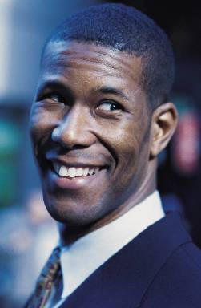

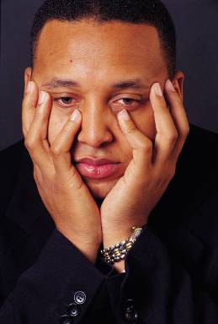


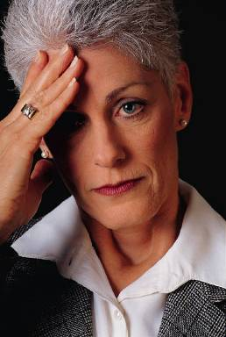






Good Day
Bad Day
© TLCPCP 2019 www.tlcpcp.com

Slide 20
At work
It is a work day, start with getting up, end with going to bed. Write down a composite of all the good moments you have had on a work day and all of the bad moments.

Slide 21
What happened that contributed to your good day?
What do you look forward to doing?
Who do you look forward to seeing?
What happens that gives you energy to deal with difficult situations?
What motivates and interests you at work OR on a work day?
What threw your day off?
Made the day bad for you?
Made you frustrated? Bored?
Took the fun out of it?
Be sure to include those daily frustrations

Slide 22
Your Good Day/Bad Day
Time Of Day | Typical | Better | Worse
Morning at home
Commute
Morning at work
Lunch
Afternoon at work
Commute
Evening
Overnight
© TLCPCP 2019 www.tlcpcp.com

Slide 23
Time Of Day | Typical | Better | Worse
Morning at home | Get up at 7:30 Have 2 cups of coffee before shower Go for a walk Let the chickens out, gather the eggs Do self reiki treatment, Skip breakfast | Sleep until 8 Breakfast is made for me so I actually eat | Don’t have time for a walk or Reiki Get woken up before 7:30 In a rush and don’t get my two cups of coffee Don’t eat until lunch If someone does the chickens for me
Commute | Drive to meetings tired or in auto pilot | Stay mindful as I drive and appreciate my surroundings | Winter drives or rainy days that make the drive gloomy
Morning at work | Get diffuser running Put music on Check email and social media messages Get started on a project or to do list | Email box is empty There is nobody around so I can focus My desk is clean and I am caught up from the day before | There are a lot of email to address before I can get to my to do list Unexpected projects or demands come up Computer needs to update Not connecting with co-workers or team mates
Lunch | Grab a salad and eat at my desk | Have time to take a break and eat at the table or outside and wander through my gardens | Eat a “quick fix” like a sandwich or junk food
Afternoon at work | Continue with to do list or meetings | Have a nap or time for a walk Able to stop working early | No time for a break or work past 4 pm
Commute | Drive tired or in auto pilot | Be mindful and appreciate the beauty around me | Drive in rain or snow or lots of traffic
Evening | Watch the Young and the Restless at 4:30 with a glass of wine Make dinner at 5:30 Watch the news and CSI or Dragons Den with my husband Go to bed by 9 | When the kids are home for dinner with us When the kids sit with us to watch tv Have time outside to relax or go for a walk in the bush or wander my gardens | Having meetings between 4:30-6:30 Missing my show No wine Its rainy or cold and not good weather to get outside
Overnight | Sleep at 9 pm until 7:30 am Wake for drinks of water or my husband is restless or watching tv | If I don’t wake at all through the night | If I have to go to the bathroom in the night When my husband wakes me to talk because he can’t sleep or wants me to have a coffee with him at 5 am

Slide 24
Work with your partner. Read their good day/bad day list.
Time Of Day | Typical | Better | Worse
Morning at home
Commute
Morning at work
Lunch
Afternoon at work
Commute
Evening
Overnight
?
Then add to the what is important to section. As you add each item, ask “Is there something that other people need to know or do to support you with that?” If there is, add to the How best to support me section.

Slide 25
good day / bad day:
Not connecting with co-workers or team mates
Important to me:
How best to support me:

Slide 26

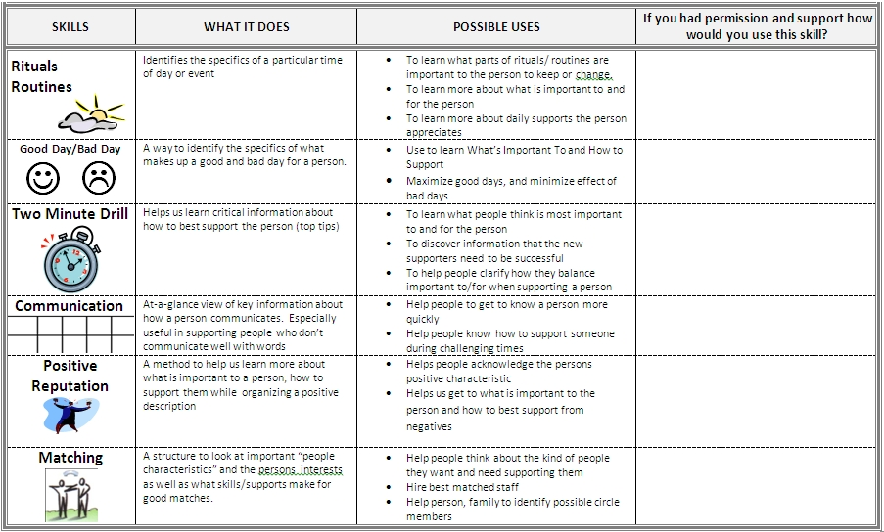
Take your important to/for you information and your 2 minute drill information and add it to your one-page profile

Slide 27

© TLCPCP 2019 www.tlcpcp.com

Slide 28
What makes sense or does not make sense about you bringing home a puppy right now.
 | What works/makes sense | What doesn’t work/doesn’t make sense
Perspective of new puppy owner
© TLCPCP 2019 www.tlcpcp.com

Slide 29
Used to organize perspectives
about a specific issue or
to get a snapshot description of NOW
What’s Working | What’s Not Working/What Could Improve
What does the person say is working? | What does the person say is not working or could be better?
What does the family say is working? | What does the family say is not working or could be better?
What does the staff person/teacher/therapist (etc) say is working? | What do they say is not working or could be better?
© TLCPCP 2019 www.tlcpcp.com

Slide 30
Video
What is and is not working from different perspectives:
Brandon
Mother
Father
Coach

Slide 31
Garth Brooks video
 | What is working | What is not working
Brandon
Mother
Father
Coach

Slide 32


Slide 33
Working/Not Working
things to keep in mind
Reflect current reality
What is working now, not what would or could work
Focus on a specific issue or area of life
Peel the onion
Always ask the question behind the question
Dig deeper to find more meaningful information
© TLCPCP 2019 www.tlcpcp.com

Slide 34
Working/Not Working
how to use it
Negotiation tool
All must feel listened to – accurately reflect perspectives
Start by focusing on common ground
Remain unconditionally constructive
It is done in partnership
Bridge to action planning
What needs to be maintained/enhanced?
What needs to change?
© TLCPCP 2019 www.tlcpcp.com

Slide 35
 | What works/makes sense | What doesn’t work/make sense
USE THIS INFORMATION TO BUILD THE
A
G
E
N
D
A
FOR THINGS THAT ARE TO STAY THE SAME
Person’s
perspective
USE THIS INFORMATION TO BUILD THE
A
G
E
N
D
A
FOR THINGS THAT NEED TO CHANGE
Disagreements
Staff’s
perspective
© TLCPCP 2019 www.tlcpcp.com

Slide 36
Given the medication that someone is taking…Ritalin
 | What’s working | What’s not working
Person’s Perspective | Able to listen and focus Able to think clearly Don’t lose my stuff People don’t get angry with me | Hurts my stomach My mouth is always dry I’m hungry a lot more Classmates know I take medications
Mom’s Perspective | More organized, stuff isn’t scattered She can sit still for periods of time She listens and engages easily More relaxed, less intense No more complaining teacher calls | She is losing weight Complains of her stomach hurting Doesn’t want to take medications Hell hours 4-8:00 pm…she is coming off medication Public school pill !!!!
Teacher’s Perspective | More prepared for school She doesn’t drift off in class Not as emotionally volatile Pays attention to class work Gets along better with classmates | Complains of stomach hurting Always asking for water Sleepy in class Class interruption (to go to nurse for medications)
© TLCPCP 2019 www.tlcpcp.com

Slide 37
Evaluating the work you are doing…
 | What works | What doesn’t work
Perspective of Person Supported
Your
perspective
Supervisor’s
perspective
© TLCPCP 2019 www.tlcpcp.com

Slide 38
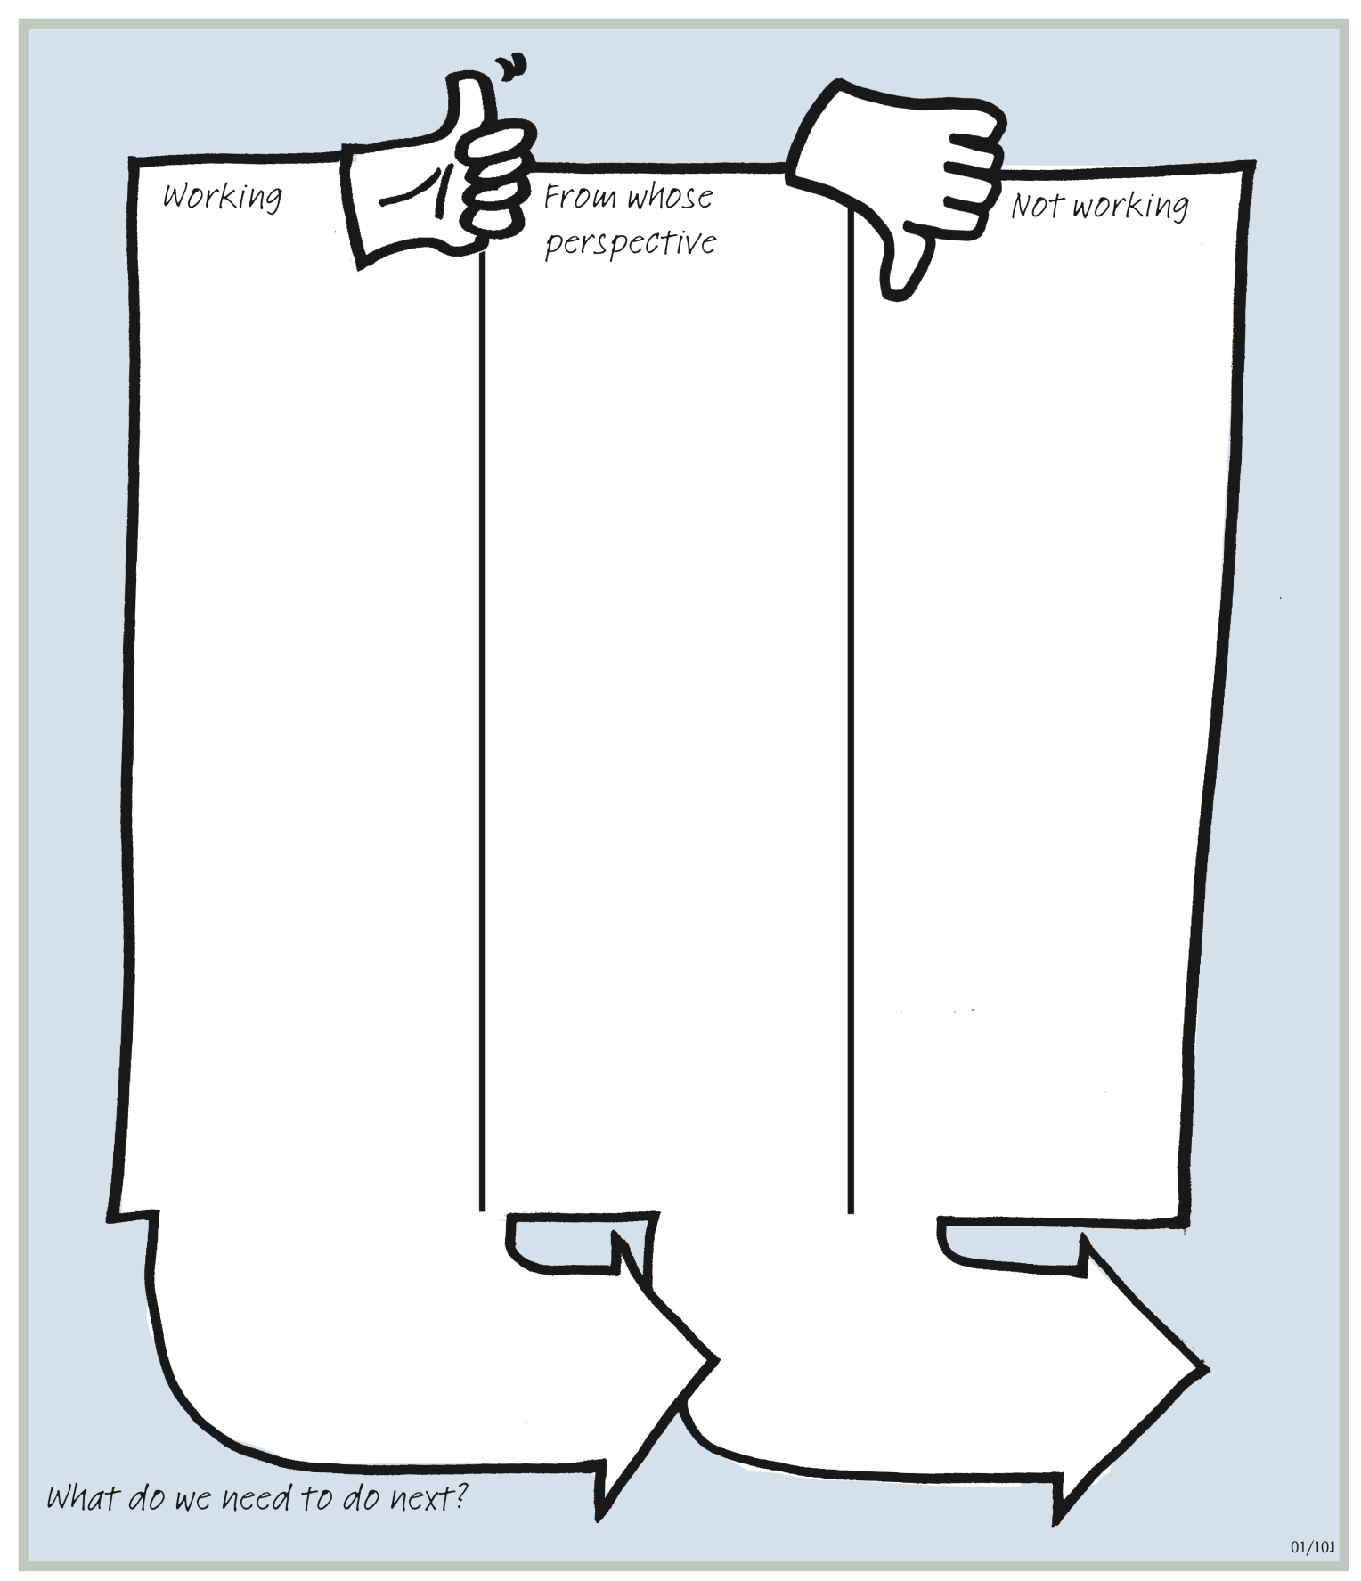
person
family
Home supports
Employment
supports
Actions to keep the same
Actions for things to change

