Slide 1

Person-Centred Approaches
Day two
Person-Centred Approaches
Day two

Slide 2
Welcome back
Review of Highs and Lows

Slide 3
”
Help people get better lives…
…not just better paper
“
© TLCPCP 2019 www.tlcpcp.com

Slide 4
How Today Works
Learn how to gather information (discover) using:
Histories
Relationship Map
Routines and Rituals
Good Day /Bad Day
Matching supports
Reputation Exercise
Organize that information in a one-page profile to keep the person at the centre of everyday support and planning
And discover information and problem solve using:
Working/Not Working
4+1 questions
© TLCPCP 2019 www.tlcpcp.com
Notes:
TLC-PCP www.learningcommunity.us

Slide 5
Histories
A conscious effort to find out and record a person’s stories can tell us so much, about them as a person, about what’s important to/for them, and who is in their life (or used to be)
Visual methods of capturing and sharing histories really helps – a powerful photo or graphic speaks a thousand words

Slide 6
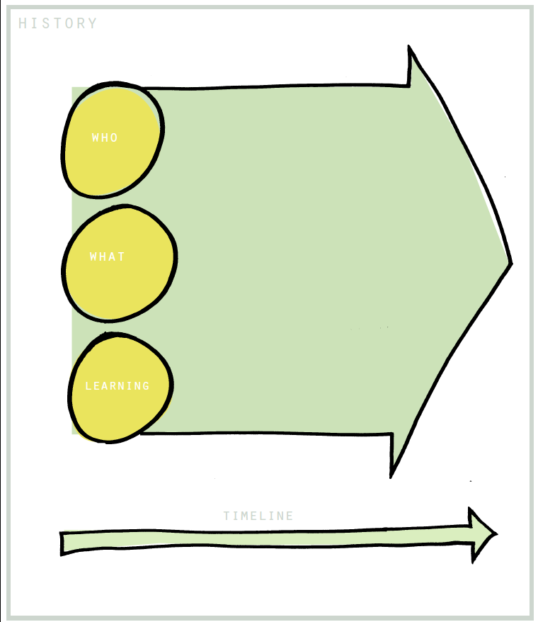

Slide 7
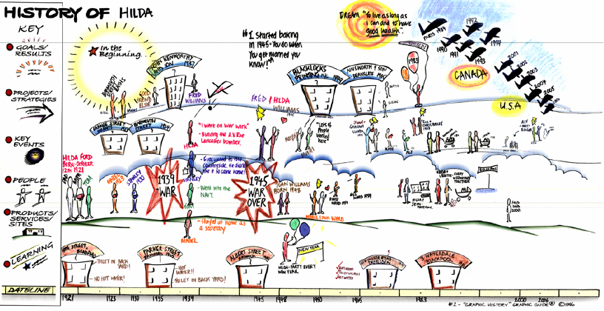
‘Some day, I may not remember what a
great life I have lived so far.’

Slide 8
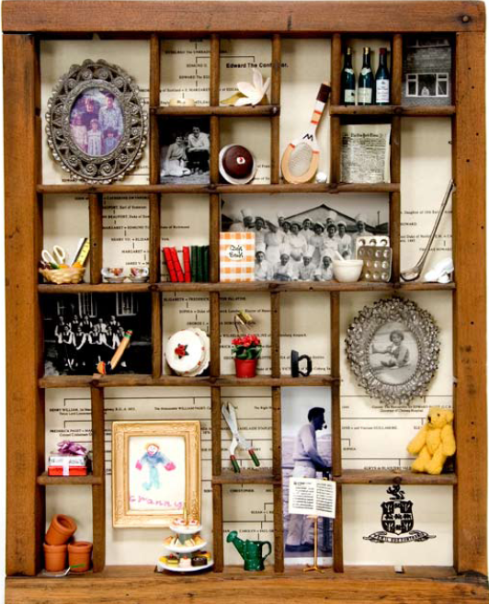
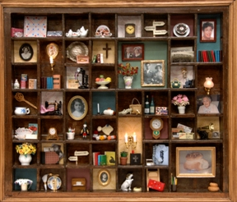

Slide 10
Organizing Discovery Information
Three ways to organize discovery information
Person centered description
Person centred / directed plan
One-page profile
Notes:
TLC-PCP www.learningcommunity.us

Slide 11
One Page Profiles
What People
Like and
Admire about
the person
One Page
Profile
Important To
the person
How to best
support
the person

Slide 12
The first questions to ask…
What is the purpose of the one-page profile? (or person-centred description or plan)
How will it be used?
© TLCPCP 2019 www.tlcpcp.com

Slide 13
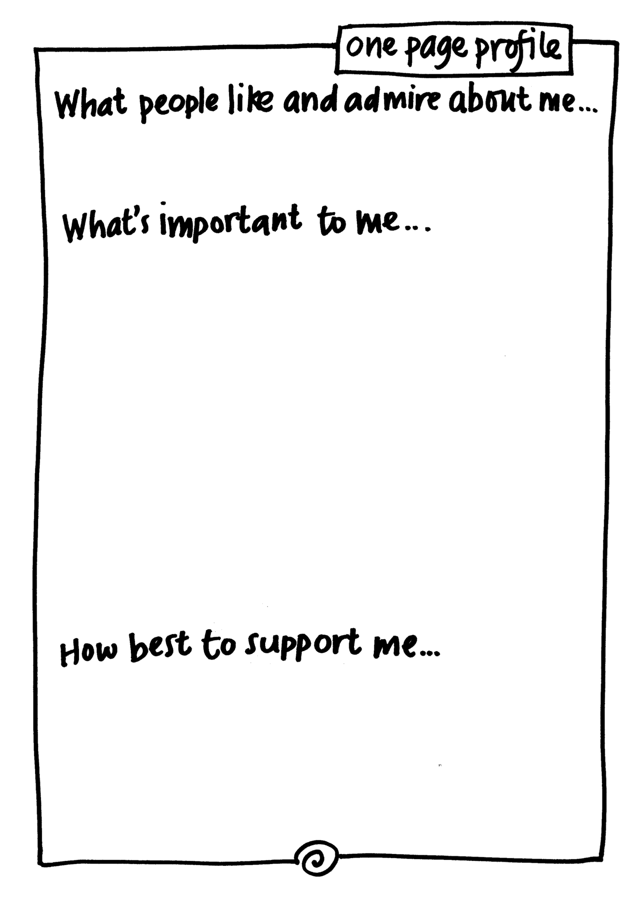

Slide 14
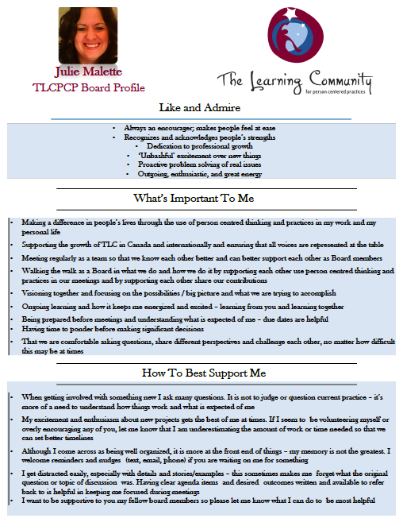

Slide 16


Slide 17
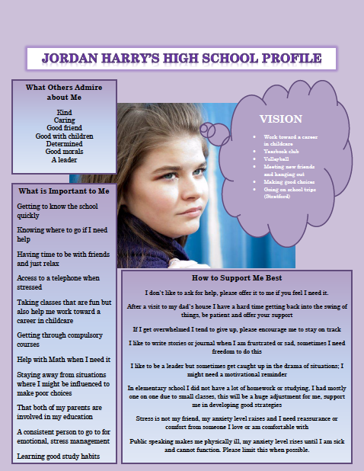

Slide 18
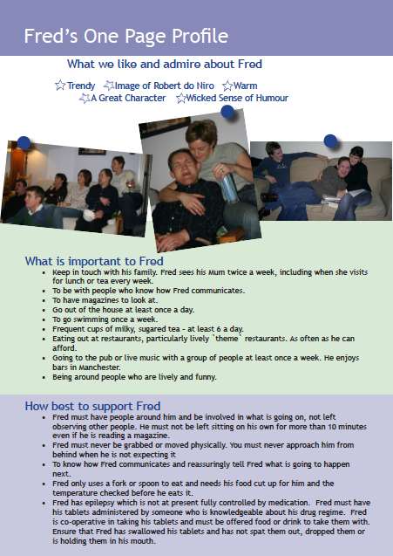

Slide 19
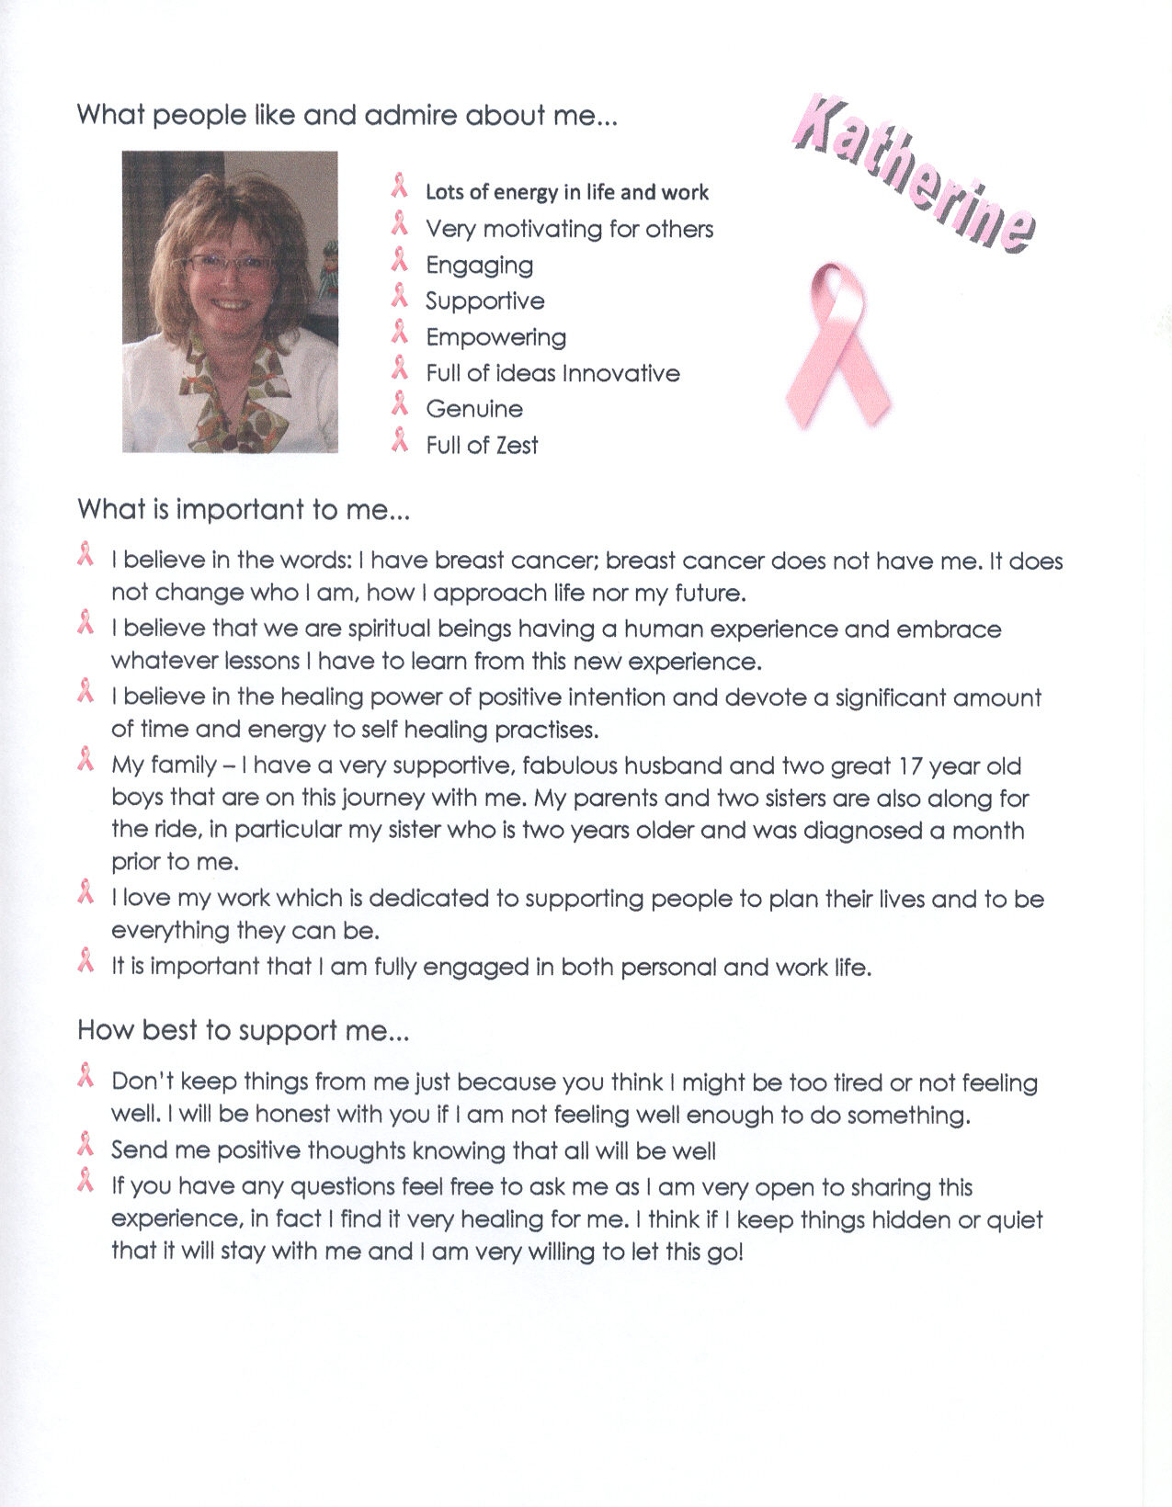

Slide 20
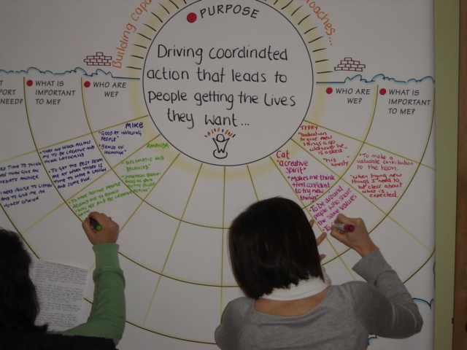

Slide 21
Relationship Circle
Circle of exchange
Circle of participation
Circle of friendship
Circle of
intimacy

Slide 22
Relationship Map
family
work
school
daytime
home and other paid support
Friends and other non-paid supports
Notes:
PURPOSE:
Relationship map
To teach people a good way of finding out who is important to the person.
To identify who to talk to and involve in person-centred planning and supporting the person
To emphasize how different the relationships are in their lives when compared to many people who use services.
TALKING POINTS:
Review your own relationship map with the group (on flip chart)
Let people know that they will only have a five minutes to fill this out, so they may not have time to be thorough or thoughtful. Tell them “this is training and we want you to know how the various pieces work but you will not have time to finish everything.”
Then –
Ask people to start with their partner’s name in the center (unless you do it individually) and only share what you are comfortable sharing.
Let people know that it is emotional distance that determines where names go, not how close the “blood” relationship is. Note that if you changed how you feel about someone their name could move closer to the center or further away. Also note that this is more about emotional connectedness and strength of feelings toward a person vs. how much time they spend with them
When people start to struggle with the quadrants for people who are paid – ask them where they would put their doctor, the person who cuts/does their hair. Other people that they see regularly and pay
When they are done (or out of time) note that this –
Gives us a picture of who is in someone’s life and who they care about
Gives us ideas about who we should talk in order to develop a good picture of what is important to the person
Ask how their “map” would compare with that of the people who use our services
TOOLS:
Flip chart paper with your own relationship map drawn on it.
FACILITATION TIPS:
Start by using your own example on flipchart, use a few personal examples to explain and emphasize the key messages. Know ahead of time which examples you will use.
Keep in mind that this is one of the areas where you could spend 5 minutes or 25 minutes. Some people will not have time to complete it. Part of what you want people to see is how their “maps” are rich in friends and have few people who are paid, whereas the “maps” of people who use services are often the reverse.
Wrap-up the exercise by asking participants for their thoughts on how this tool might be helpful in their lives/work.
TIME: 10 minutes

Slide 24
Relationship Circle and Map
Who in the person’s circle can help connect them to other people in their circle or to new people?
Does the information gathered help identify relationships that could be developed and strengthened?
Is there a good balance of family, friends, and paid workers in the person’s life?
How should we gather the information so it is useful to the person? Some people prefer to use photos to develop their relationship circle.
Are all the people important to the person mentioned in their ISP/Person-Centred Plan? Have we learned anything new we need to add?
Are there any actions we can set based on what we have learned?
© TLCPCP 2019 www.tlcpcp.com

Slide 25
Learning about Support
Power Over
Power With
Supporting vs Fixing
© TLCPCP 2019 www.tlcpcp.com
Notes:
TLC-PCP www.learningcommunity.us

Slide 26

Supporting vs Fixing

Slide 27
7 Questions you should be able to Answer for each Person you Support
What is important to the person?
What is important for the person?
Is the connection between important to and for addressed?
Is there a “good” balance between important to and important for?
What does the person want to learn, what do we need to learn?
If the person is to get the balance described and we are to learn:
What needs to stay the same (be maintained or enhanced)?
What needs to change?
© TLCPCP 2019 www.tlcpcp.com

Slide 28
Facilitation skills are needed to…
Have meaningful conversations
Ensure that the person we plan with remains in charge as we learn
© TLCPCP 2019 www.tlcpcp.com
Notes:
TLC-PCP www.learningcommunity.us

Slide 29
Two ways to have a conversation…
Linear
Branching
© TLCPCP 2019 www.tlcpcp.com

Slide 30
Being mindful of Question Types that
will limit what you learn
Close ended questions that lead to yes/no answers
-Do you like shopping?
-Is watching television important to you?
Leading questions with built-in answers
-You like going shopping don’t you? (while nodding your
head yes)
-Jane is your friend isn’t she?

Slide 31
Questions that help us learn more
of what we need to know
So tell me more about that…
What do you like about…
What is it about this…
What is happening for you then?
Are some mornings better than others? What makes them better?
© TLCPCP 2019 www.tlcpcp.com
Notes:
TLC-PCP www.learningcommunity.us

Slide 32

Having a conversation

