Slide 1
Person-Centred Approaches
Orientation Session

Slide 2
Welcome

Slide 3
www.hsacanada.ca

Slide 4
The Learning Community for Person Centered Practices
envisions a world where all people have positive control over the lives they have chosen for themselves. Our efforts focus on people who have lost or may lose positive control because of society's response to the presence of a disability. We foster a global learning community that shares knowledge for that purpose.
© TLCPCP 2019 www.tlcpcp.com
Notes:
4

Slide 5
Program
Orientation session–
Tech Tips and getting started
Person-Centred Approaches – 5 sessions

Slide 7
Technology
Zoom – same link every session,
view, name, camera, sound, breakout groups, chat, annotation
Slack – invites have been sent, channels, top tips
Top tips resource

Slide 8
Breakout rooms
Facilitator
Keep things moving
Remind of 1 person at a time
Encourage everyone to participate
Timekeeper
Keep eye on the clock and give people reminders of how much time is left.
When using timed rounds, let people know when their time is about to end
Recorder/Reporter
Keep things moving
Remind

Slide 9
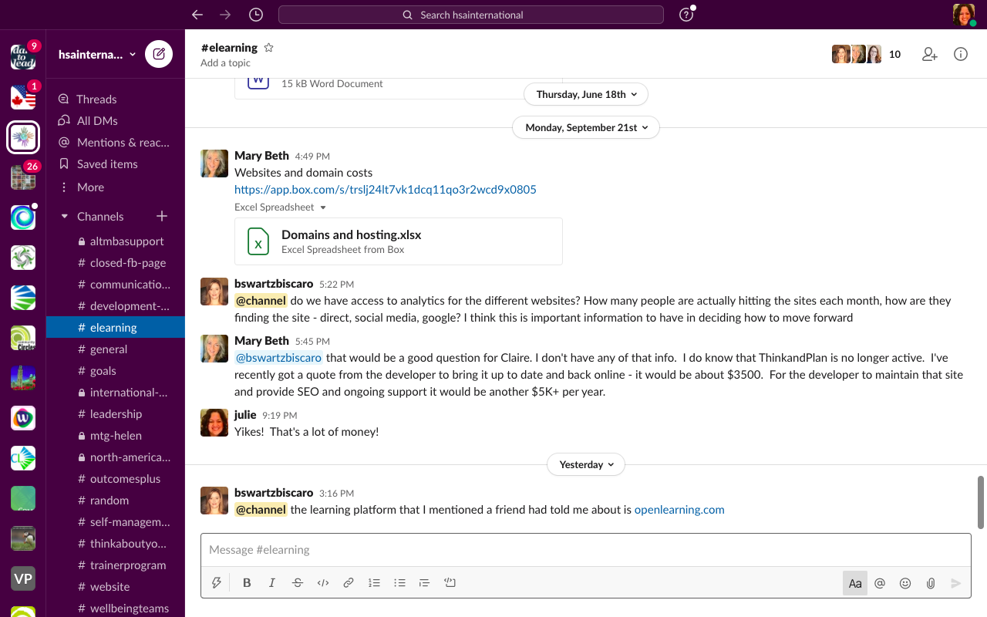

Slide 10
How the training will work
Practical application of tools
Post questions and helpful examples on Slack
Attendance

Slide 11
Each of us want lives where we are
supported by & contribute to our communities
Have our
own dreams and our own journeys
Have opportunities to meet
New people; try new things; change
jobs; change who we live with & where we live
Have what/who is important to us in everyday life; people to be with; things to do, places to be
Stay healthy & safe (on our own terms)
© TLCPCP 2019 www.tlcpcp.com

Slide 12
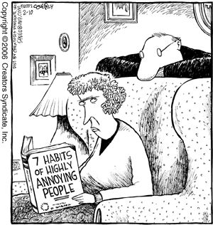
What grates on your last nerves?
© TLCPCP 2019 www.tlcpcp.com

Slide 13
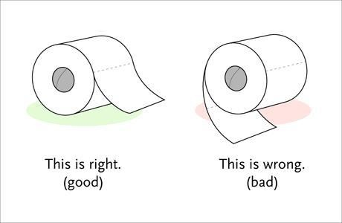

Slide 15
Things that people do at home
that gets on your last nerve

Slide 16
How do you react? What do you do?

Slide 17
1 year later
same situation plus a system response
How do you feel now and what do you do?

Slide 18
5 years later
person-centred planning
No change
How do you feel and what do you do?

Slide 19
What would it take to trust?

Slide 20
Person-centred planning or using person-centred thinking tools is a set of promises
To listen
To act on what we hear
To be honest
© TLCPCP 2019 www.tlcpcp.com

Slide 21
”
Help people get better lives…
…not just better paper
“
© TLCPCP 2019 www.tlcpcp.com

Slide 22
Importance Of Environments
Toxic
Tolerated
Healing
Supportive
Causes significant aggression or depression.
What is toxic to one person may not be toxic to someone else
Results in Power Over as we try and control the aggression or withdrawal
People are depressed, have given up.
We see “learned helplessness”
May have been toxic but people feel powerless
There is no (or very little) growth
Power Over
In a supportive setting there is growth.
People have moved from toxic or tolerated “blossom.”
There is Power With
This is the minimum for everyone.
Needed for some people wounded by toxic or tolerated settings
Focus is on restoration and wellness. There is a need to partner with clinical supports
Power With
© TLCPCP 2019 www.tlcpcp.com

Slide 23
“
Person-centred thinking and planning is a process of continual listening and learning, focusing on what is important
to someone now and in the future and acting upon this in alliance with their family and friends.
Michael Smull
”

Slide 24
www.hsacanada.ca
www.tlcpcp.com
barbs@hsacanada.ca
juliem@hsacanada.ca

