Slide 3
epilepsy sensor in bed
camera and intercom system

Slide 4
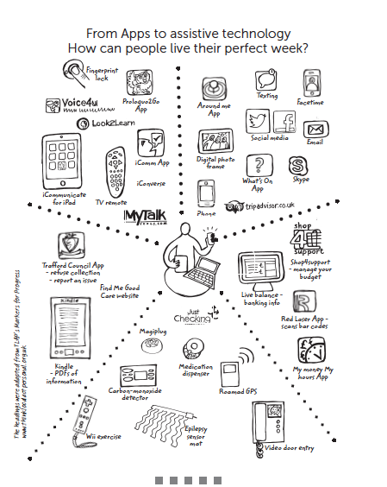

Slide 5
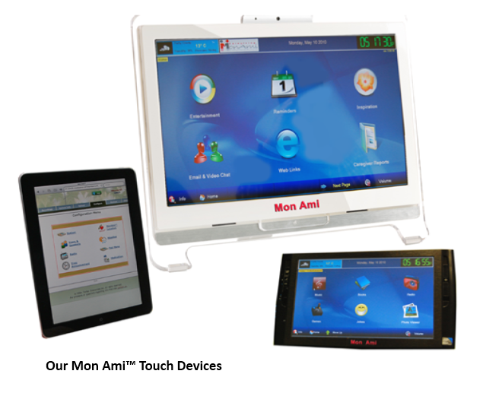

Slide 7
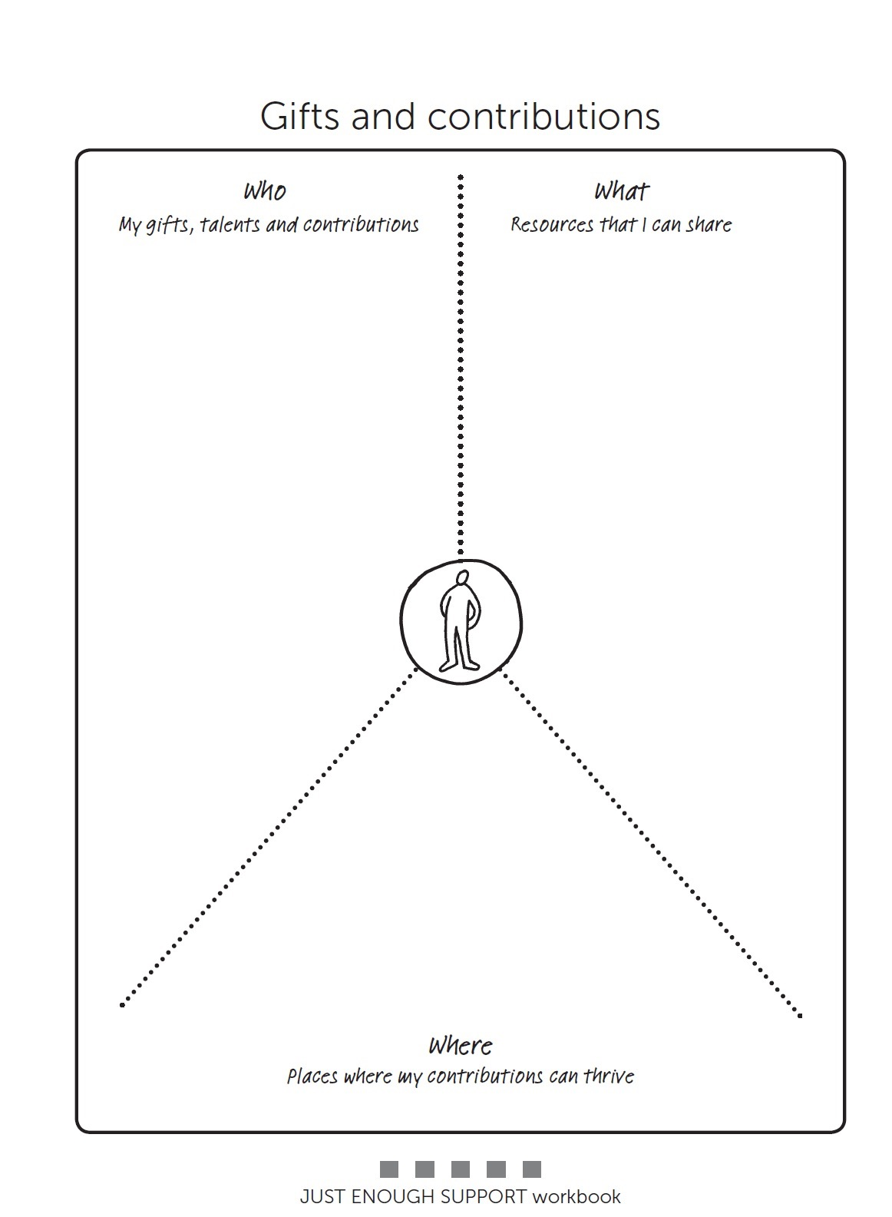
Paul
Friendly and kind
Want to help others.
Great gardener
Knows how to put a bet on.
Good neighbour.
Likes shopping.
Inquisitive.
House proud.
Social animal.
A car
Time
Willingness to help others.
Shopping for others.
A listening ear.
Keeping an eye on the street
Betting shop.
Shopping for neighbours
Dog walking
Lifts to GP appointments

Slide 8
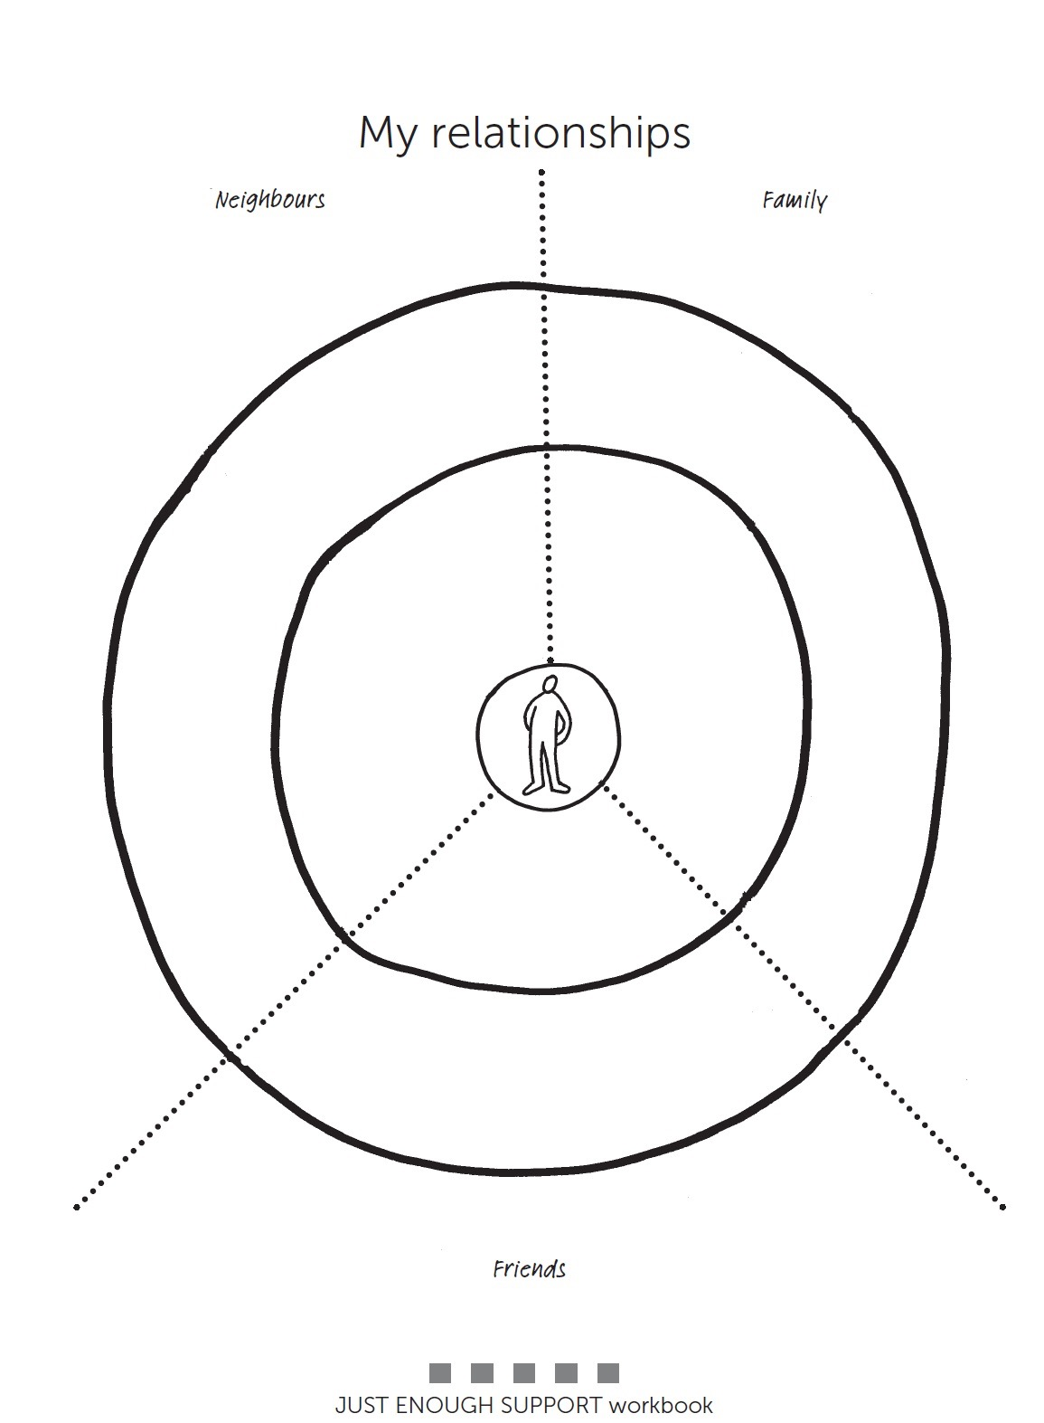
Paul
What does someone’s relationship circle look like with no paid support?
David
Nephew in New Zealand
Frank
Poppy
Alison
Edna
Barry (bookies)
Jackie
David
Joan local shop

Slide 9
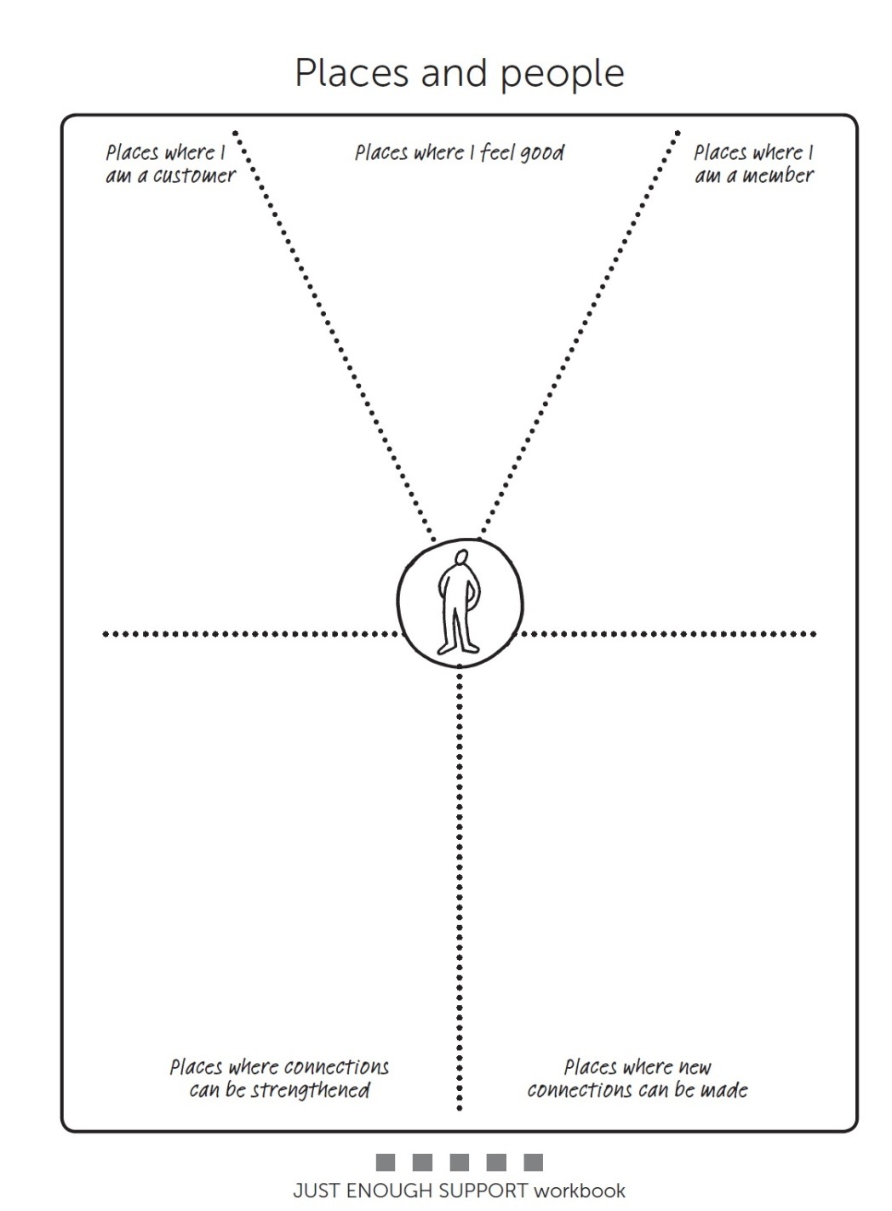
Paul
At home, Garden, Bookies, Pub, local shop, Barbers,
meeting people.
Bookies
Garden centre
Pet shop
Local pub
Chip shop
Barbers
Football
- Football
- La Davida loca
-College course, pet shop.
-Home watch
With neighbours.
At the bookies
Local pub
Garden centre.
Local shop
Home watch
Mapping the person’s community is helpful

Slide 11
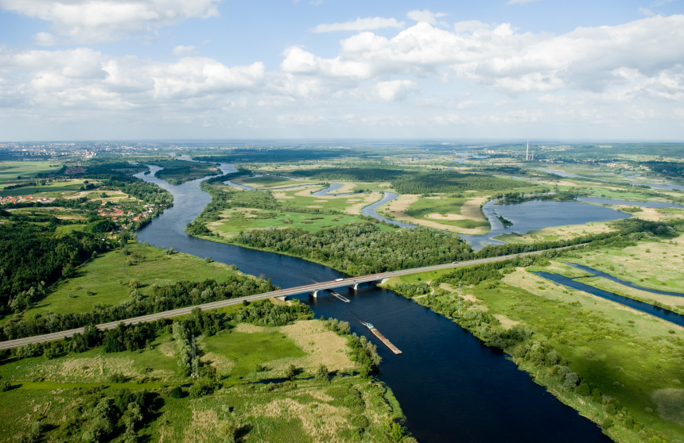
Connections are everything

Slide 13
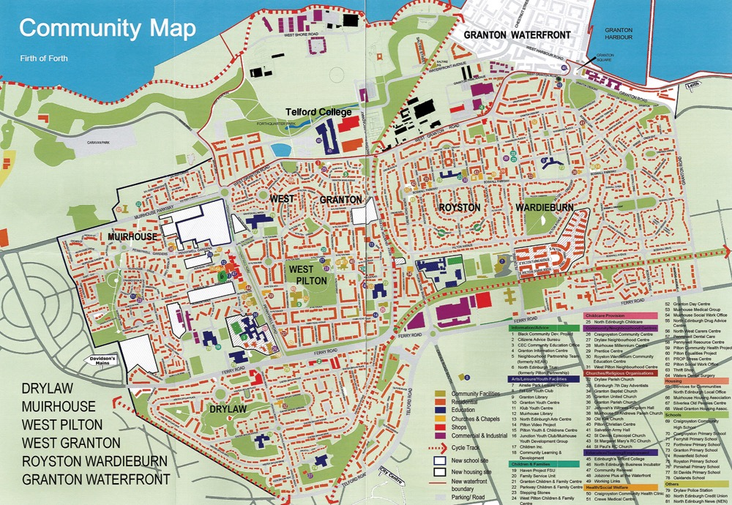

Slide 15
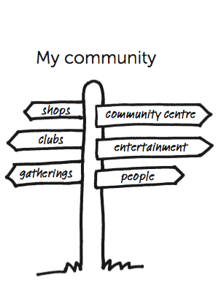
Discover what is unique about your community
Find the centre of the community and where the third places are
Find out what people do for fun together
Discover where people feel welcomed and valued
Identify the various organisations and networks in your local community
Match the person’s interests with what is present in their community

Slide 16
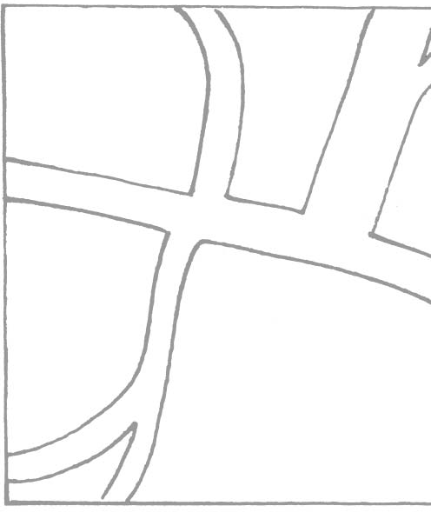
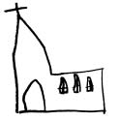
Citizens advice
Health
Centre
Yoga
Slimming club
Hospice shop
Betty
Church and Hall
flower arranging
class
Priest, Fr Simmons
home
Community centre
Women’s group
Coffee morning
George, pub landlord, darts, fishing, pool, open mike.
allotments
Library. Reading group.

Slide 17
Paul
At home, Garden, Bookies, Pub, local shop, Barbers,
meeting people.
Bookies
Garden centre
Pet shop
Local pub
Chip shop
Barber’s
Football
- Football
- La Davida loca
-College course, pet shop.
-Home watch
With neighbours.
At the bookies
Local pub
Garden centre.
Local shop
Home watch
Dog walking club.
Helping out at bookies.
Shopping for neighbours.
Football.
Gardening locally.
Home watch.

