Slide 1
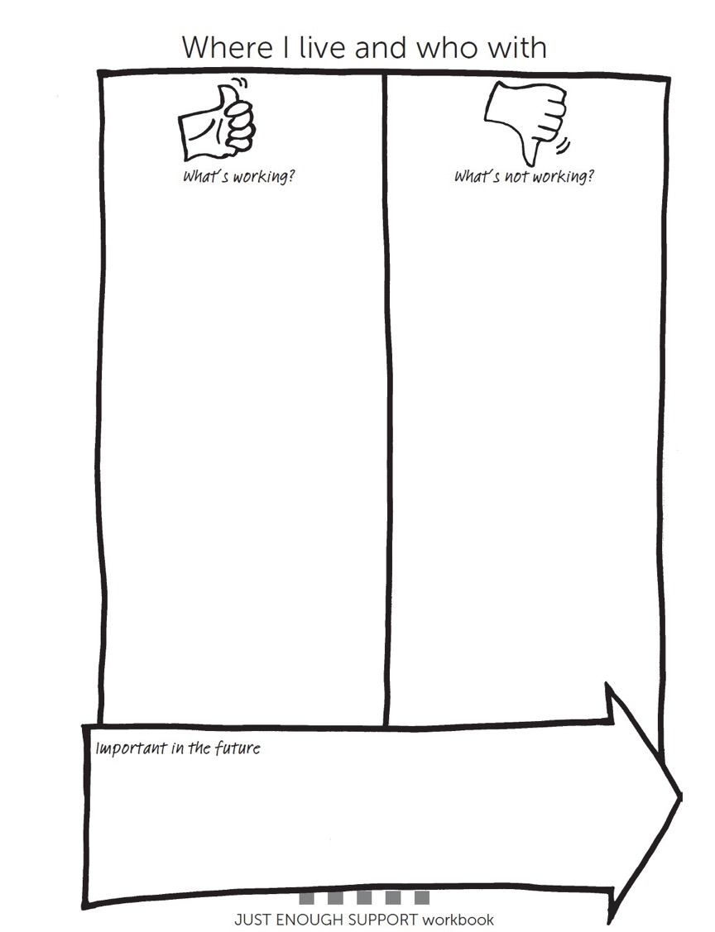
Paul Working/not working about where I live right now
Living on my own.
The staff I have chosen.
Having my pets, dog and fish.
A great garden to grow plants, veg etc.
Having a routine.
Being safe and secure.
Close to the bookies, local shop.
Being over protected.
Not having time on my own without staff.
Feel like I have little independence.
Not enough friends.
Not doing things in local community on my own.

Slide 2
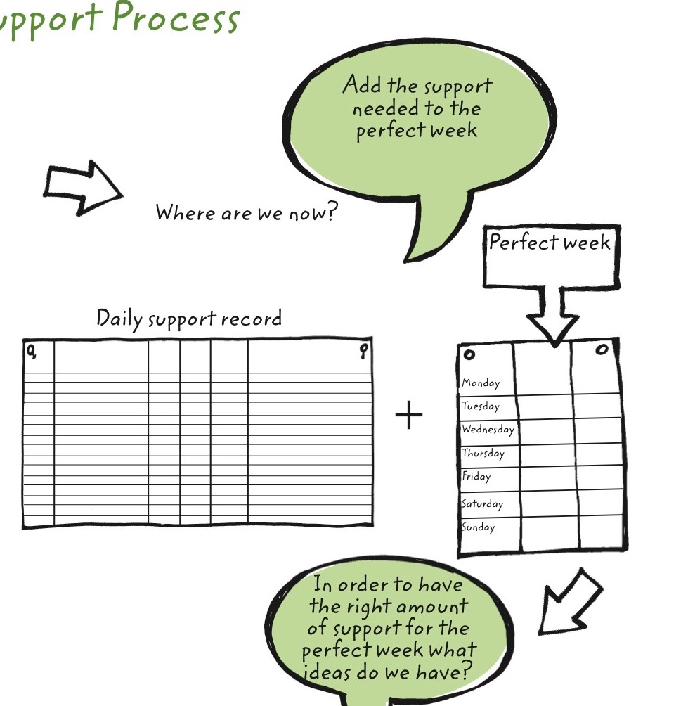

Slide 3
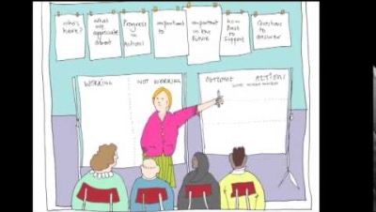

Slide 4
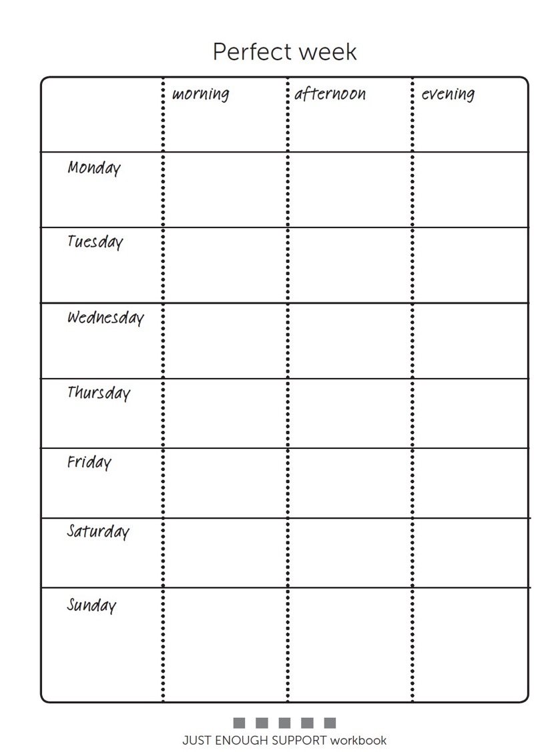
My Perfect Week

Slide 5
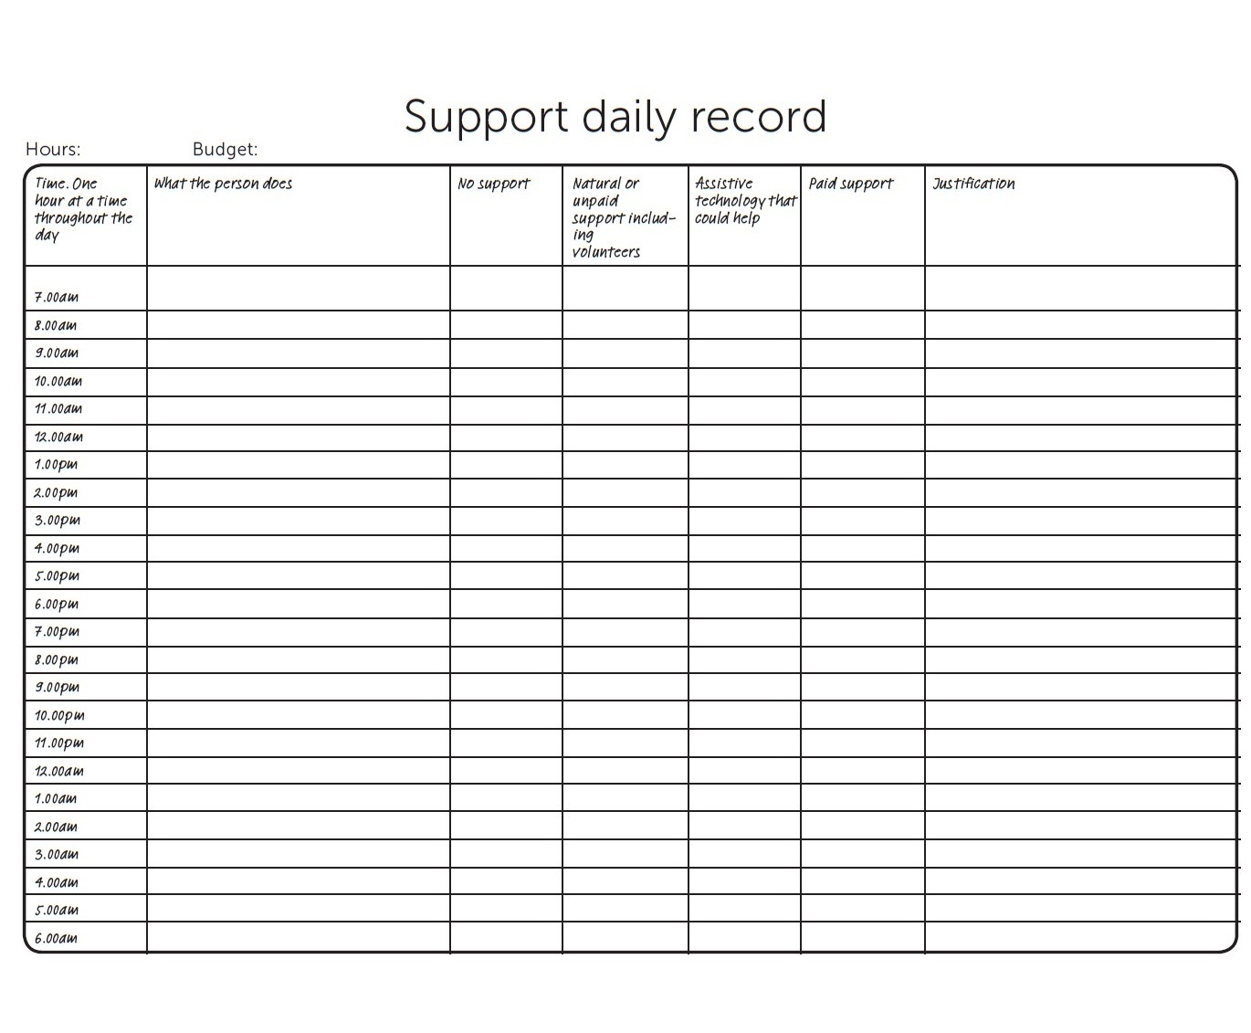

Slide 6
