Slide 3
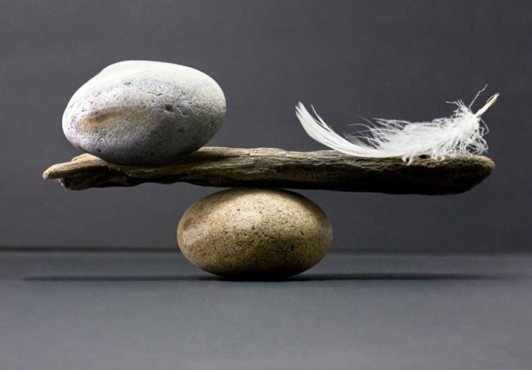
Just Enough Support
Notes:
Ruth's organisation. - PCP work - unpicked people over supported. Less money
ll together now - doesn't tell you how.
The Bauhaus chair starts with the function the why a chair is about siting on - creative thinking - do need need four legs

Slide 4
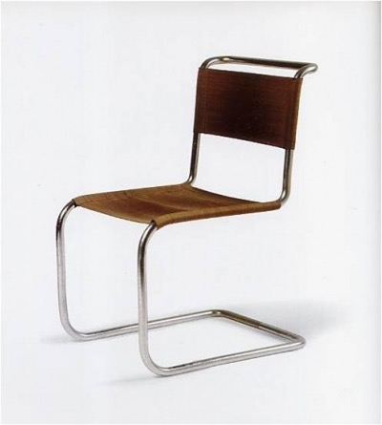
Just Enough Support
Notes:
Ruth's organisation. - PCP work - unpicked people over supported. Less money
ll together now - doesn't tell you how.
The Bauhaus chair starts with the function the why a chair is about siting on - creative thinking - do need need four legs

Slide 5
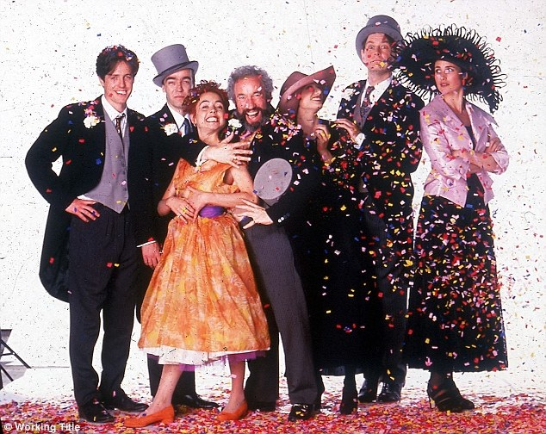
Notes:
10 mins
Fill out information in the workbooks not flip chart paper.

Slide 6
wedding planners

Slide 8
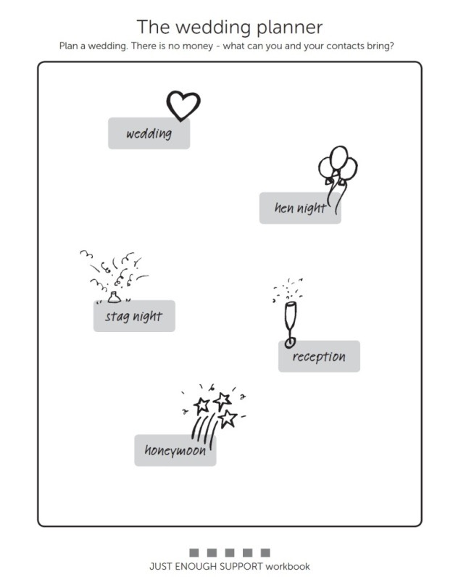
The Wedding Planner
Plan a wedding There is no mon

Slide 9
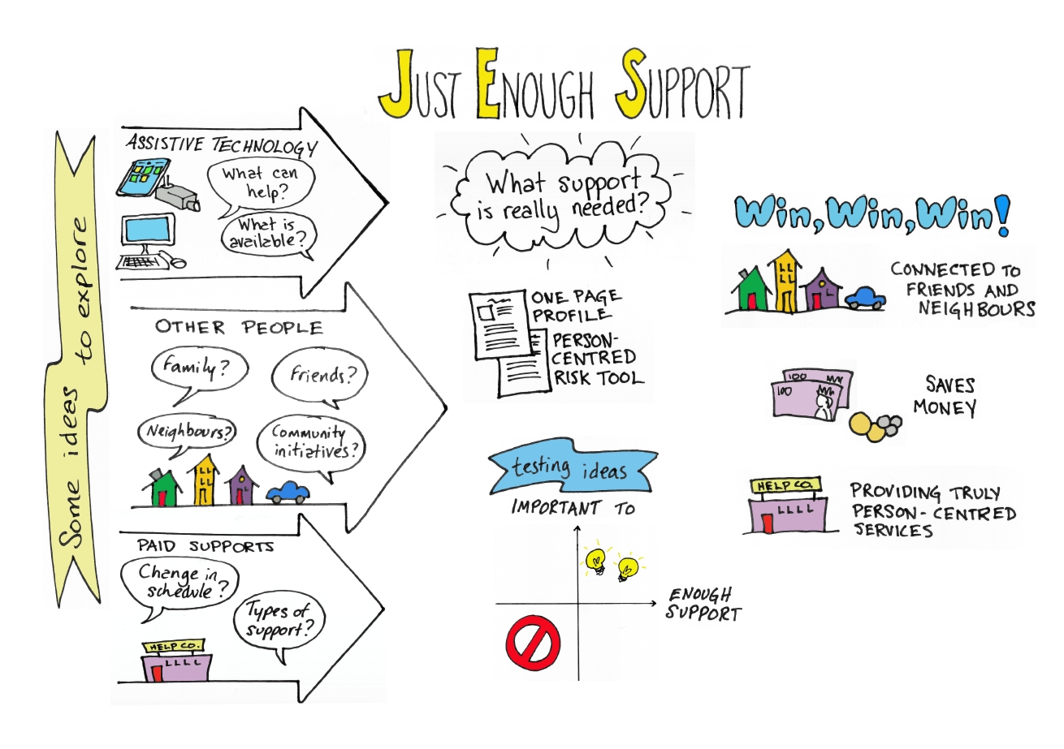

Slide 10
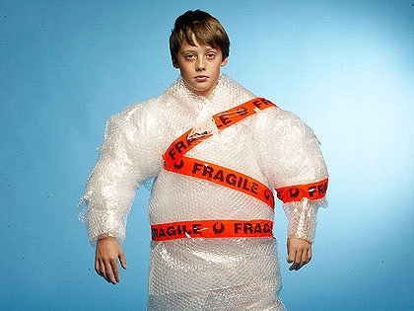
Why?

Slide 11
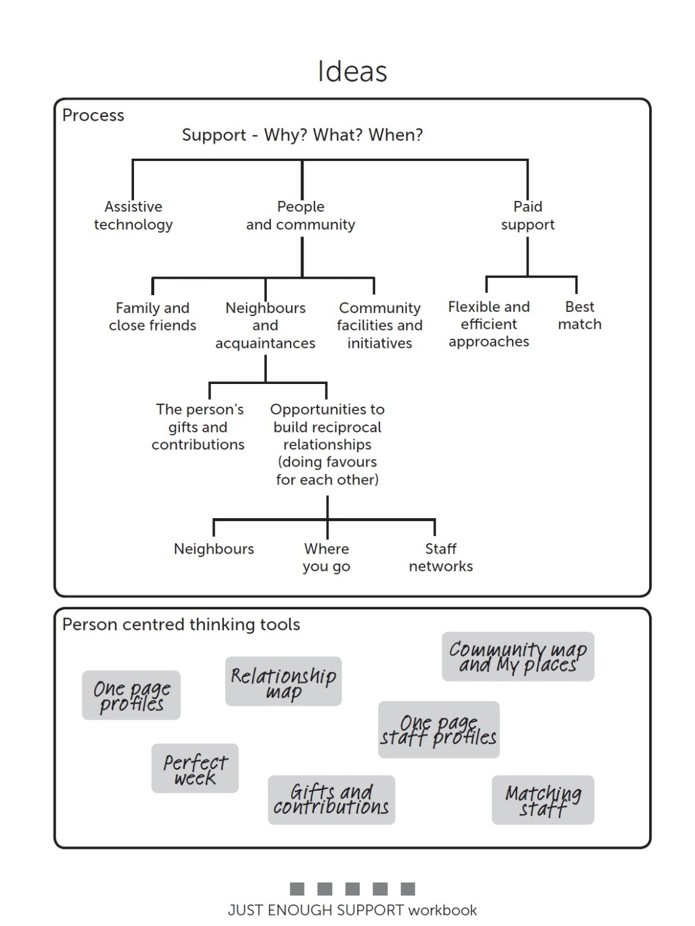

Slide 12
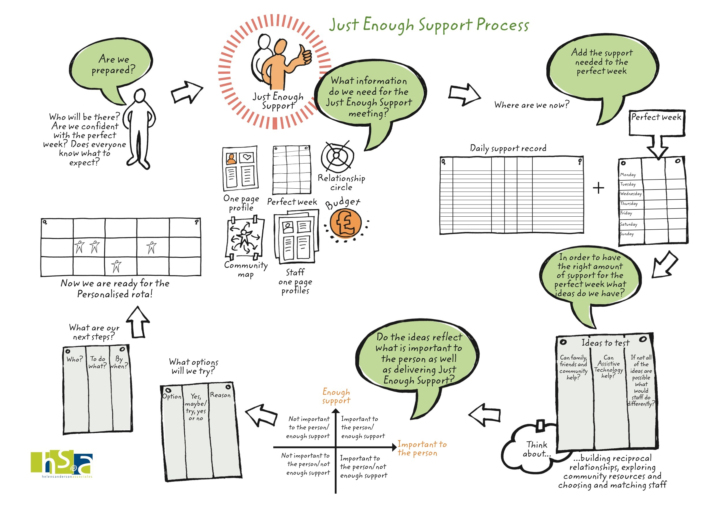
$

Slide 13
$

Slide 14
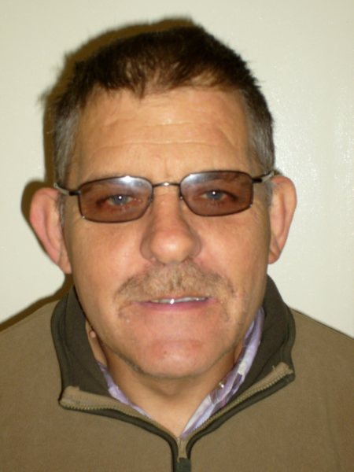

Slide 15
One page Profile for Paul
What people like and admire about me
Helpful and caring, always the gent, health and safety conscious, great sense of humour, responsible pet owner, friendly, approachable ,an enquiring mind, polite, enjoys a laugh, lucky gambler, good gardener. Good neighbour.
What’s Important to me
Poppy the dog.
My family and Edna
My pets and looking after them.
Talking overseas to family in New Zealand.
Feeling safe and secure
Likes a gamble and smoking.
Very house proud.
Gardening and selling veg/hanging baskets .
Own home and independence.
Having staff I have chosen.
To be helpful to others
How to best support me
I have an enquiring mind and need things explained to me especially about the news.
I must be involved in all decisions about my life.
Encourage me to make new friends in the community.
Support me around my health issues, I have epilepsy.
I like a bet and to smoke don’t nag about this.
Never talk down to me.
Treat my home with respect.

Slide 16
